Slide 1
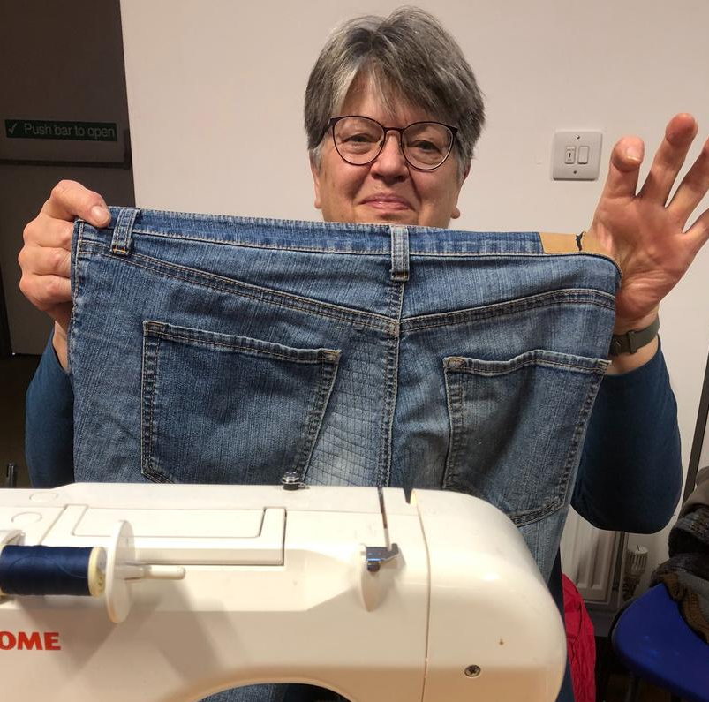
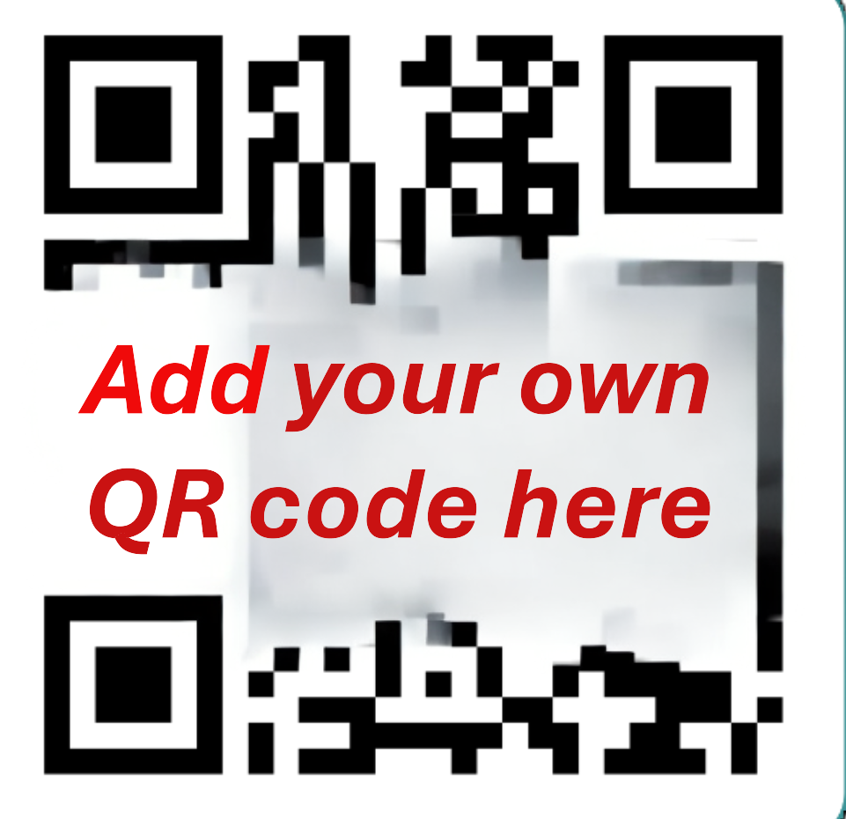
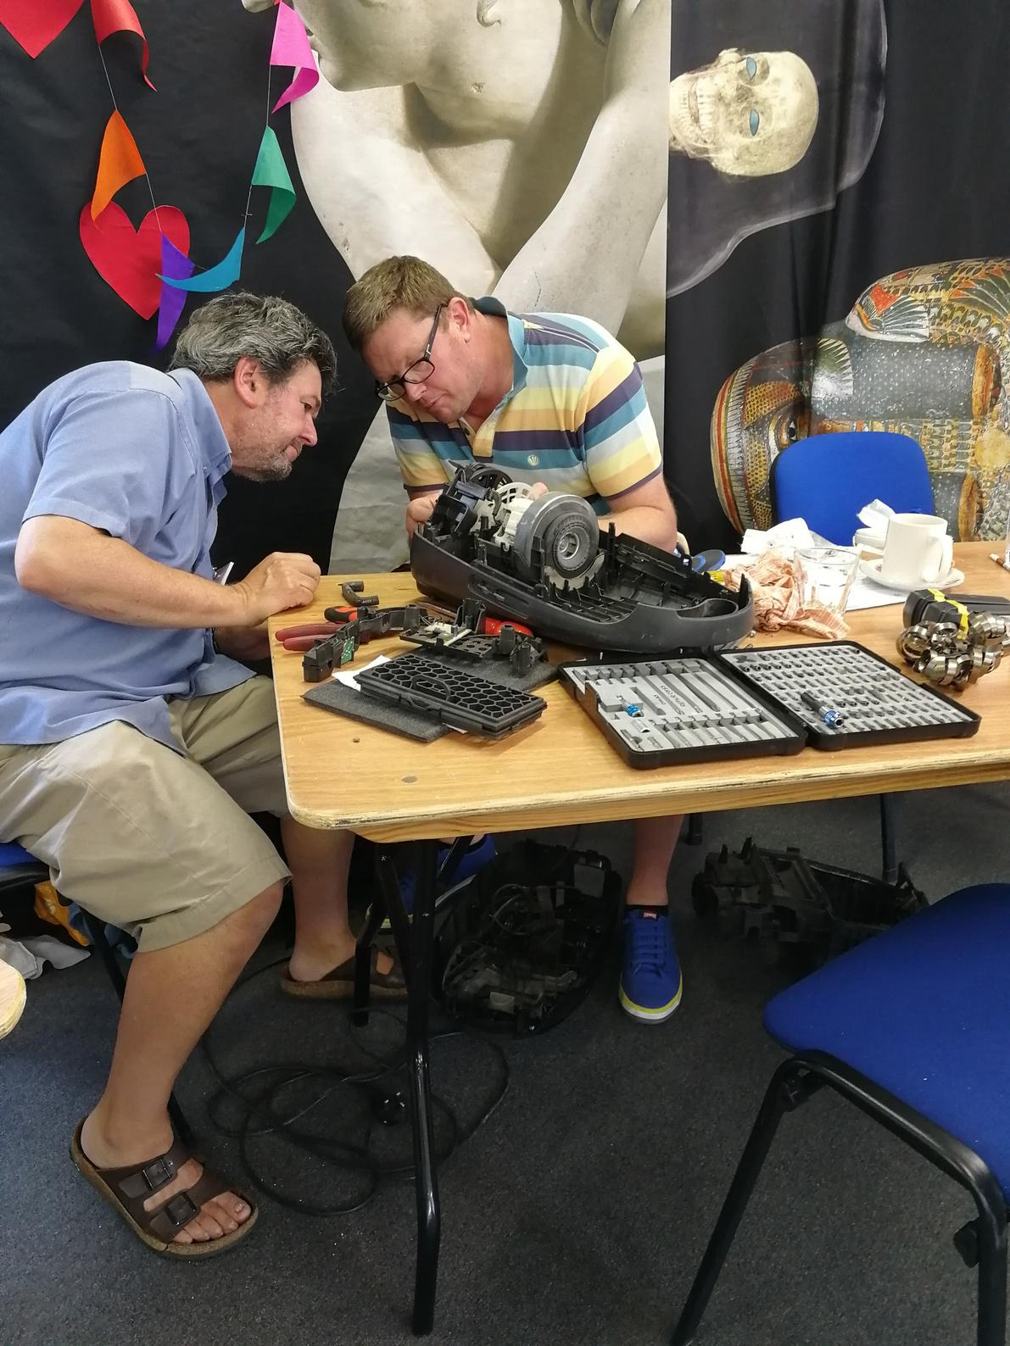
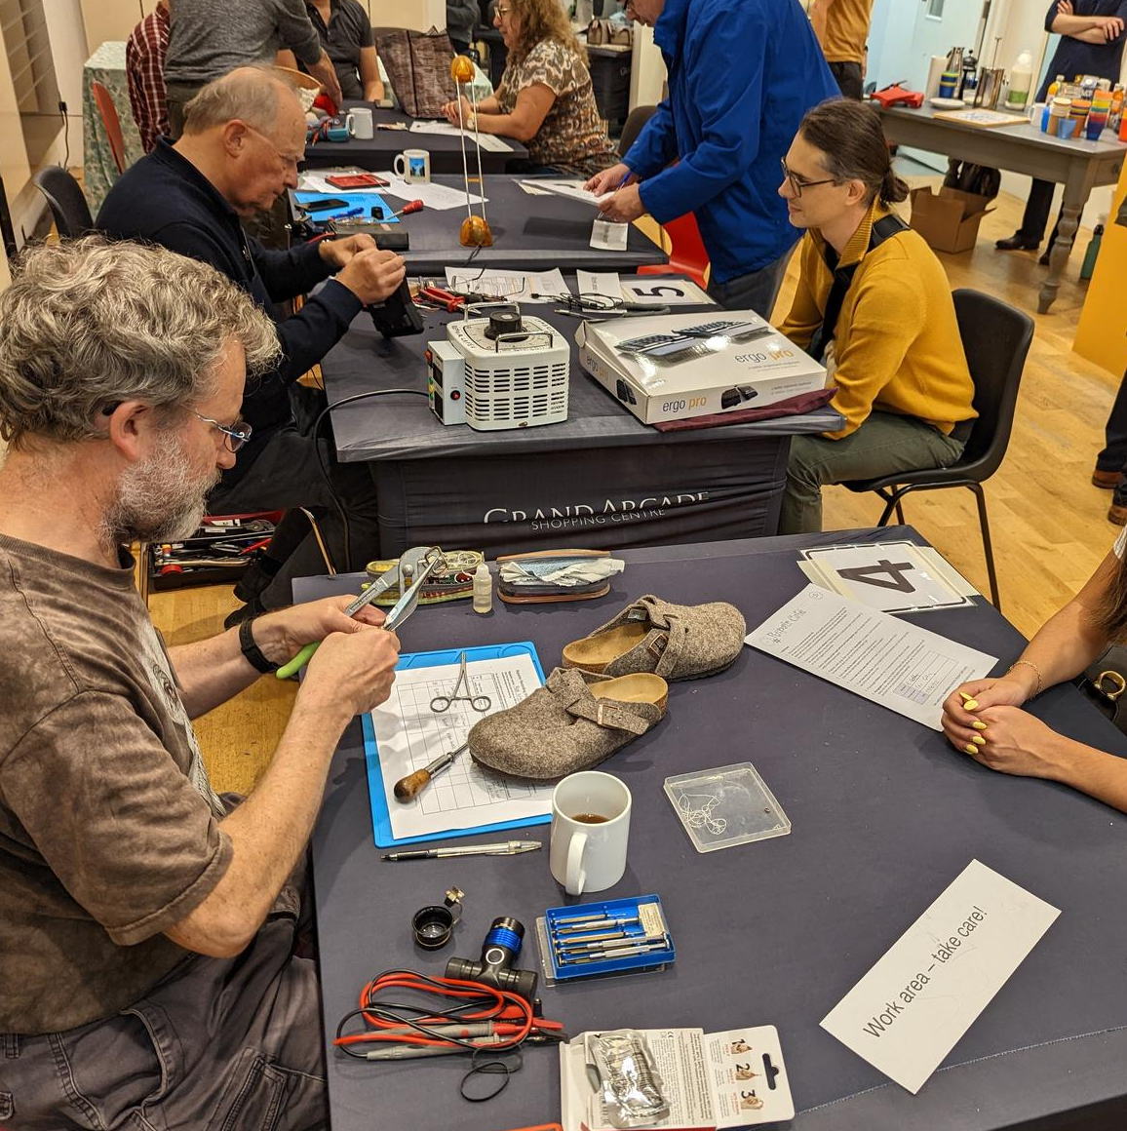



Date Time Location
REPAIR CAFE
Matching experienced volunteer repairers with people who need stuff fixed.
Book in your item for repair via
YourRepairCafe@email.com or QR code
Refreshments available.
We welcome electrical and non-electrical household and gardening items, gadgets, clothing and jewellery.
Repairs are FREE but donations are gratefully received.
Add your logo here

