Slide 1
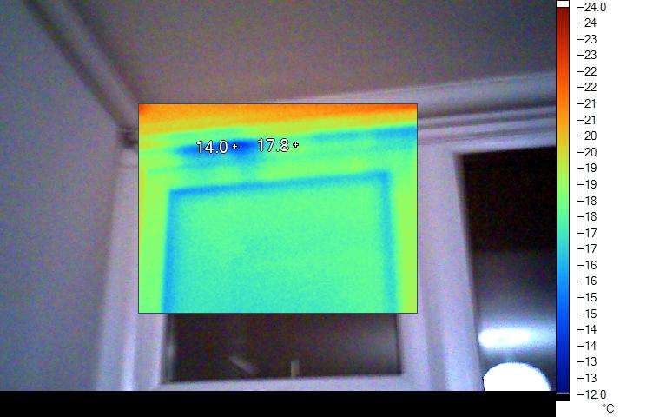
Infiltration at the top of the window frame
Thermal Images: reveal draughts (when air flows in)
This is a badly fitted window. The feathery edge to the cold patch is a key feature of draughts.

Slide 2
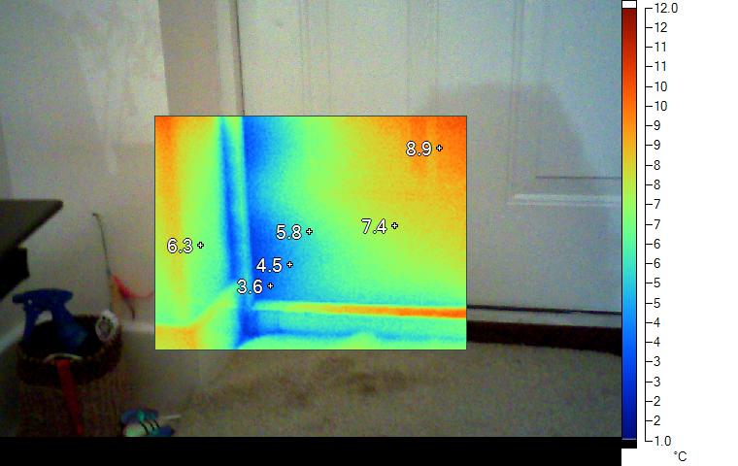
Infiltration around an external door
Thermal Images: shows draughts (where air flows in)
Some draught stripping would help here.

Slide 3
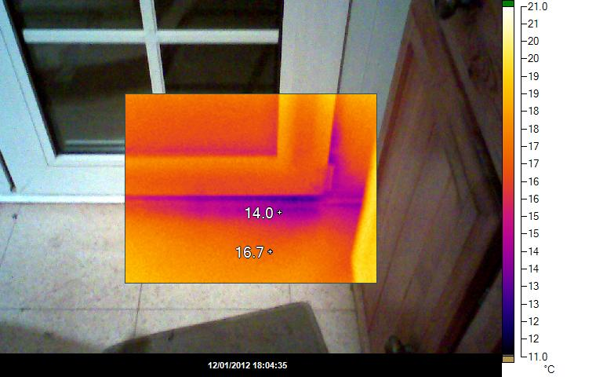
Draught at the bottom of the door
Thermal Images: find draughts
This door is not closing properly against the step. Draught stripping would help but actually this is not too bad.

Slide 4
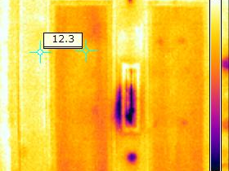
Draught through a letter box
Thermal Images: find draughts
This letterbox is not closing properly and air is leaking through and around the frame.

Slide 5
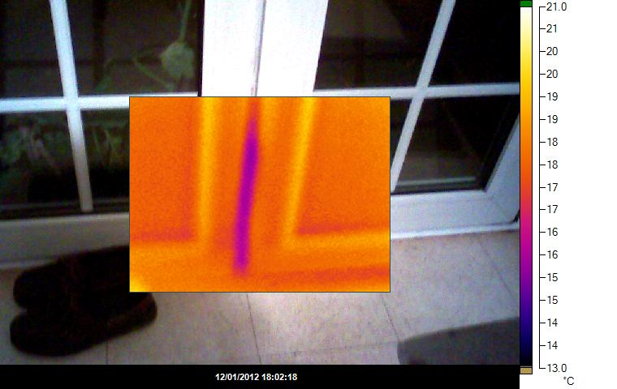
Infiltration through french windows
Thermal Images: find draughts
It is tricky to fix draughts in french windows - in this case there is a problem just in the lower part of the door.

Slide 6
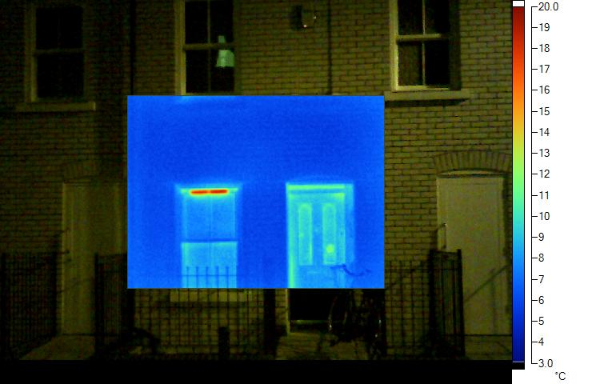
The vent above the window is open
Thermal Images: find open vents
Heat is streaming out through the vent above this window. Some windows have fixed vents, in other cases you can close the vent. But you do need some ventilation in each room so you may want to leave it open.

Slide 7
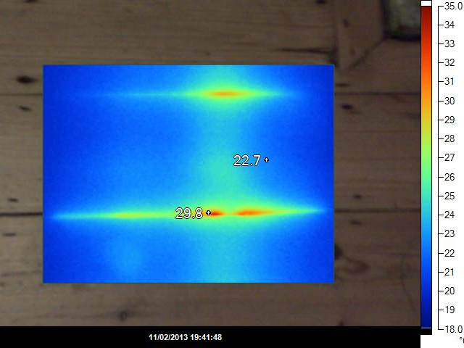
Unlagged heating pipes
Thermal Images: find missing insulation
The heat is leaking up from under the floor - pipes under the wooden floor are heating the underfloor void and need to be lagged.

Slide 8
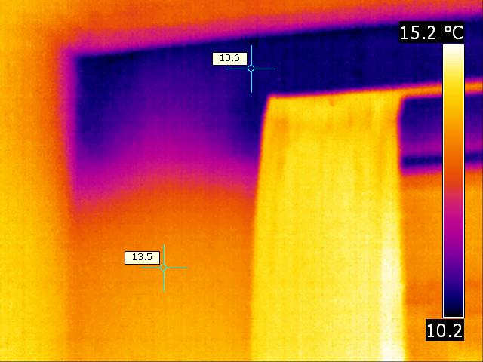
Slumped cavity wall insulation
The top of this first floor bedroom wall is much colder than the rest. It could be that cavity wall insulation has slumped, or it was never filled properly.

Slide 9
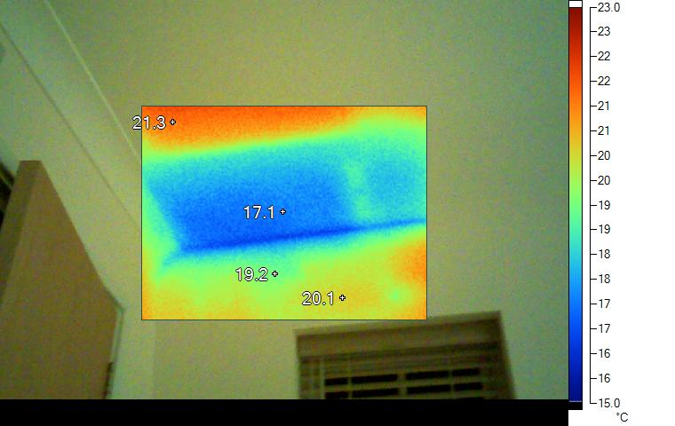
Insulation not taken to the edge of the roof
Thermal Images: find missing insulation
This is a first floor room below the loft above which is insulated – but not to the edge. Sometimes this is necessary to make sure there is enough ventilation around the wooden roof beams but this gap is larger than usual.

Slide 10
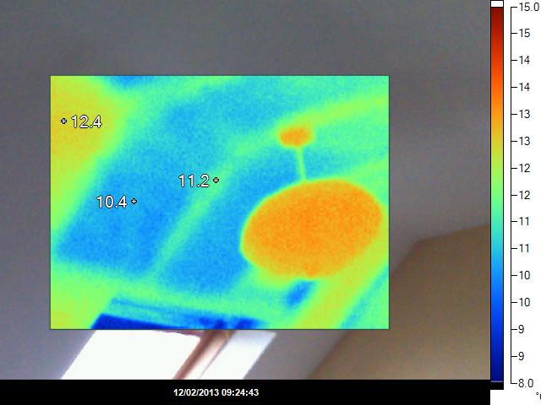
Missing insulation panels
This is in the sloping ceiling of an attic room. There is insulation on the left but two large cold sections are missing to the right of it. That is a large area with 2C difference in temperature which is a significant heat loss.

Slide 11
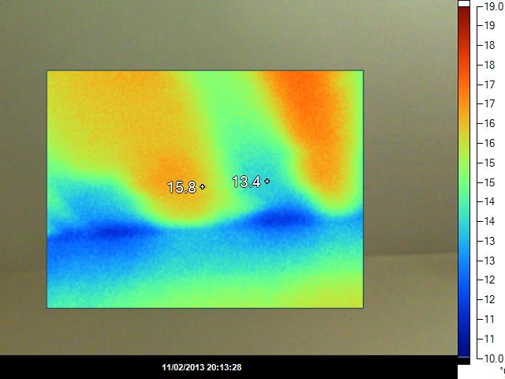
Insulation not to the edge of the roof
This is not so clear but it looks like missing insulation at the edge of the roof, It may or may not be possible to fix it while retaining ventilation around the rafters.

Slide 12
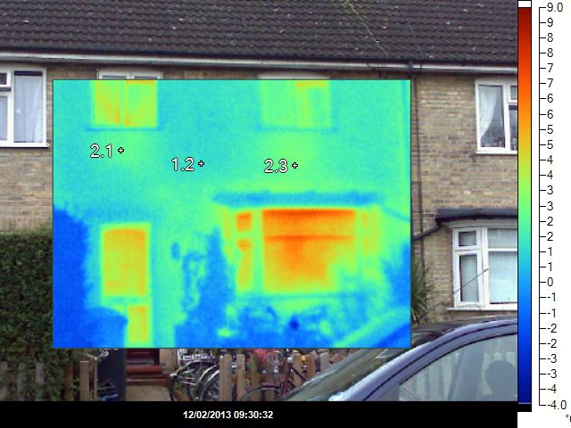
Missing radiator panels,
There is heat loss from under the windows, where radiators are warming the walls. Radiator panels would help. This picture was taken in the morning and curtains were open. You can see the windows are warm, especially the front sitting room.

Slide 13
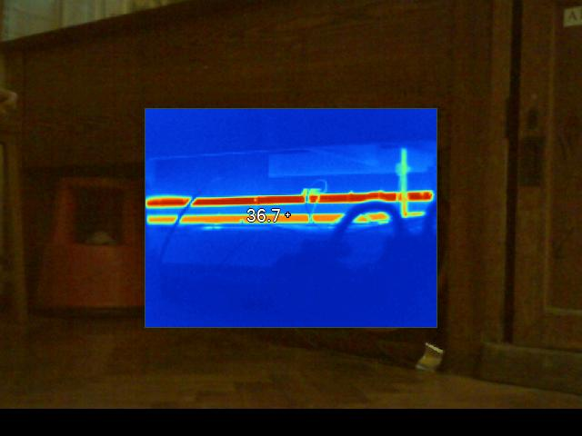
Unlagged pipes
These pipes (at the back of kitchen cupboards) are not lagged.

Slide 14
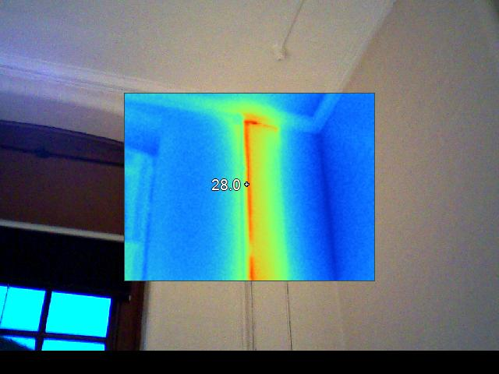
Heat leaking from hot water pipes
Thermal Images: find missing insulation
The heat loss from the pipes shows they need more insulation to stop the heat leaking out. If these are radiator pipes and the heat loss is useful then there is no problem. If they feed taps then the heat loss is definitely not wanted especially in summer.

Slide 15
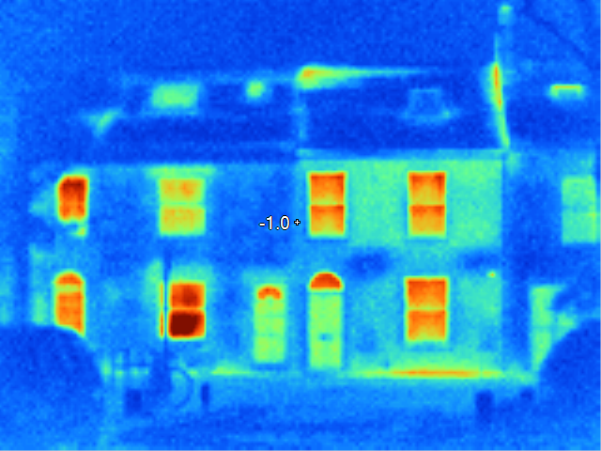
Several heat leaks from the outside
Note the high heat loss at ground level, especially on the right, probably from the underfloor void. Floor insulation would reduce this. Also heat leaking from the chimney - could be bad pointing. If the hot spot on the ridge is not a vent this needs checking.

Slide 16
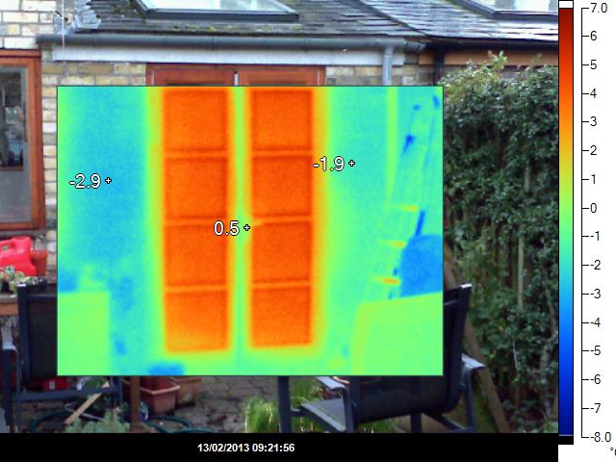
Windows leaking heat
These French windows are double glazed. The windows are much warmer than the walls, though still much cooler than inside. Maybe they need an upgrade.

Slide 17
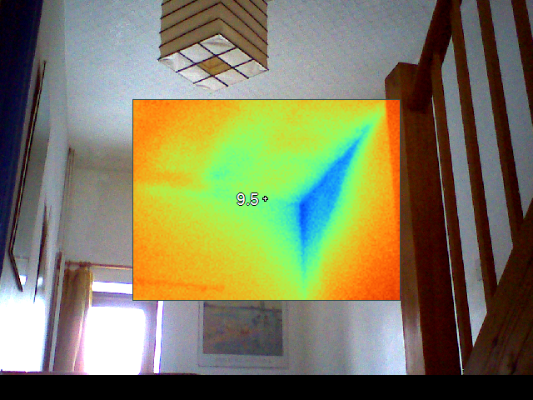
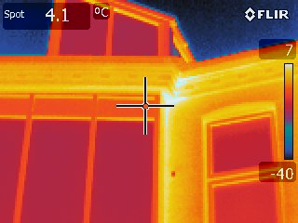
Heat leakage around insulation
Thermal Images: show thermal bridges
The front wall of this house is insulated externally but the neighbour’s house is not. The party wall is cold in the corner because the heat leaks through from the front wall of the next house.

Slide 18
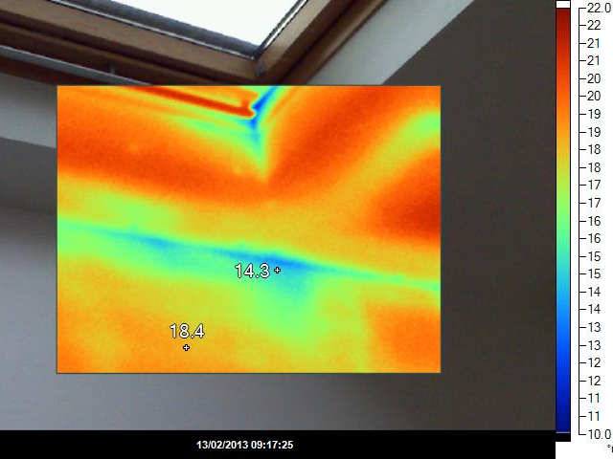
Thermal bridge at the top of the wall
There seems to be a cold bridge at the junction between the wall and the sloping roof. (The window is fine).

Slide 19
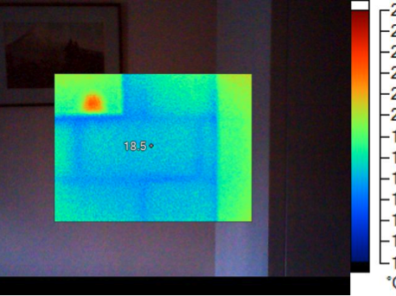
Breeze blocks in the wall
Thermal Images: reveal structure
This was a dormer room which has been plastered straight over the masonry: you can see the outline of the breeze blocks under the plaster. This is not a problem that needs fixing but it is interesting to see it.

Slide 20
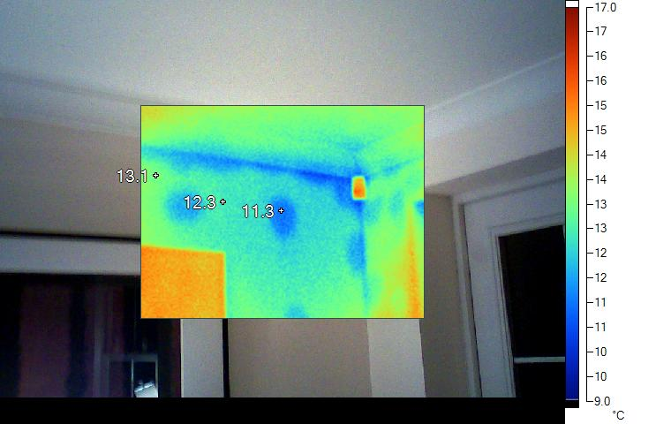
Plasterboard adhesive
Thermal Images: reveal structure
The regular splodges are dabs of glue holding the plasterboard in place. The glue transmits heat effectively to the masonry behind. Between the splodges the plaster doesn’t quite touch the solid wall so there is a small air gap. This is not a defect that needs fixing – the areas are small and the temperature difference is only 1C.

Slide 21
What is a reasonable surface temperature? (rough guidelines)
The surface temperatures depend on factors including
Internal and external air temperature
Air speed, moisture, radiant heat
Surface texture.
Outside, the weather is variable and temperature differences are smaller: less accuracy, less useful.
As a rough guide:
Walls (insulated) – not more than 2°C difference between inside surface of internal and external walls.
Windows (double glazing or better) – not more than 5°C difference between inside surface and internal walls

Slide 22
What is a reasonable surface temperature? (how the calculation works)
Outside
Tout = 2°C
Inside
Tin = 20°C
The air temperature is 2°C on the outside and 20°C on the inside. Through the wall the temperature gradient depends on resistance. Surface resistance on the outside (Rse) depends on the weather!
Consider a wall with U-value 0.5 W/K, Total R = 1/U = 2
Tdiff = 20 – 2 = 18
Tout - Tse = Tdiff*Rse/R
Tin - Tsi = Tdiff*Rsi/R
Rse=0.04*
Tse=2.4°C
Rsi=0.13*
Tsi=18.8°C
* Widely used rule of thumb but not reliable
R = 2
 | U (W/K) | Rse/R | Rsi/R | Te -Tse (°C) | Ti - Tsi (°C)
Single glazed window | 4.8 | 0.19 | 0.62 | 3.5 | 11.2
Double glazed window | 2 | 0.08 | 0.26 | 1.4 | 4.7
Solid wall | 1.6 | 0.06 | 0.21 | 1.2 | 3.7
Cavity wall | 0.5 | 0.02 | 0.07 | 0.4 | 1.2
Only 1-2°C below Ti

