Slide 1




Introduction to Retrofit
30 October 2025

Slide 2

Agenda
7:30 pm | Introduction
7:35 | Video introduction https://www.youtube.com/watch?v=xRbqwFto9Xs is 5:18 long ‘3 retrofits in 5 mins’
7:40 | Presentation
8:10 | Q&A
8:30 pm | Thanks and feedback

Slide 3

Retrofitting homes
Why retrofit
What is a deep retrofit
How to do it
Matthew Tulley Rob Leedham
30 Oct 2025
+ =

Slide 4
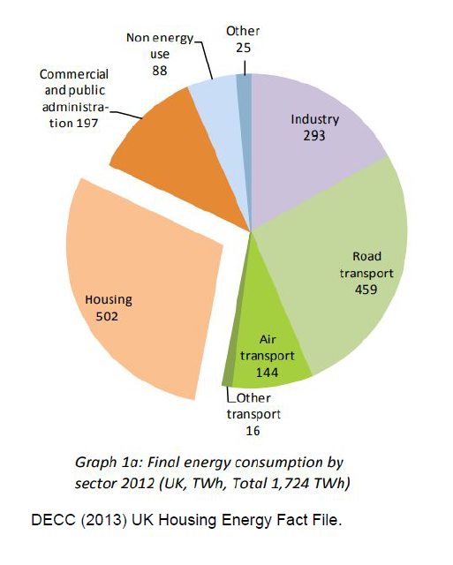
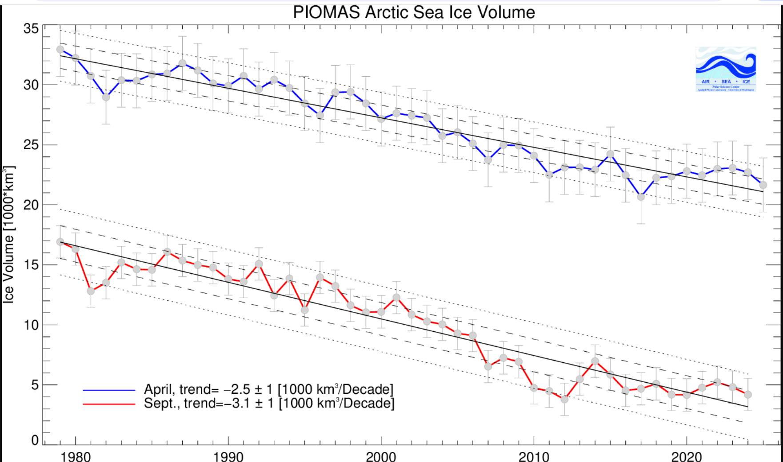
Climate context
Ice Piomas
1950 to now Theo lifetime
Muana Loa CO2
1950 to now
COP target
Housing energy
UK energy & houses
Piomas – Arctic Ice

Slide 5
Why retrofit – heat retention
PH
OK
Poor
Overnight heat loss (CH off for 10 hours, C/10C/10 hours)

Slide 6
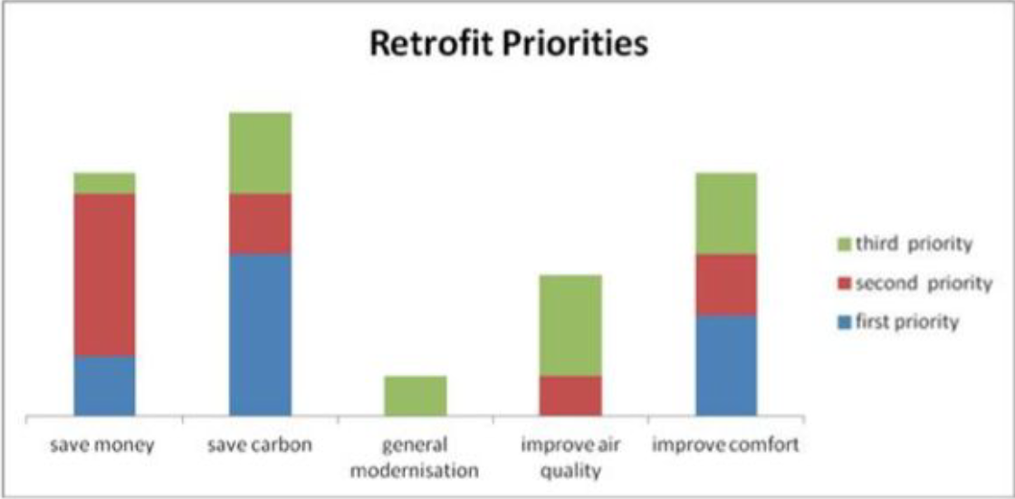
Why deep retrofit – motivation
Base Case:
= Minor retrofit + heat pump (+battery)
OK for 90% of homes
Graph from Carbon Coop
Why retrofit drivers
Ref: Carbon Coop for Priorities graph

Slide 7
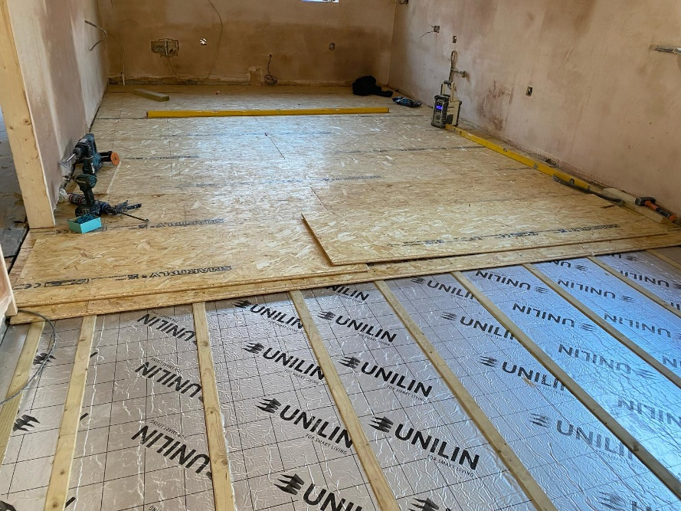
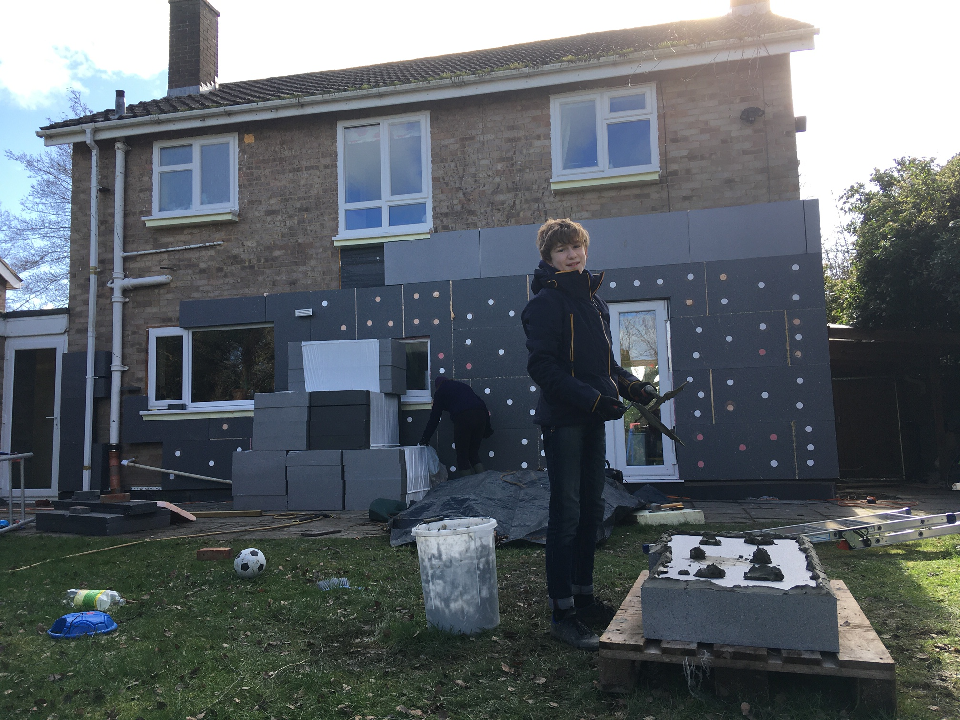
What is deep retrofit - Insulation
Picture of under floor insulation (77GR??)
Picture of EWI (Ireland)
And Windows, Doors, Roof

Slide 8
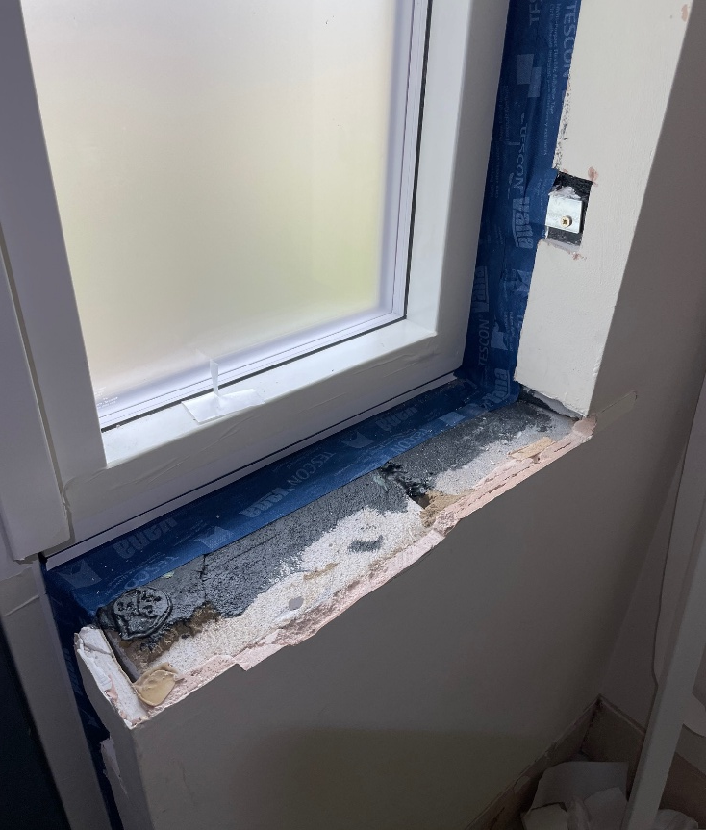
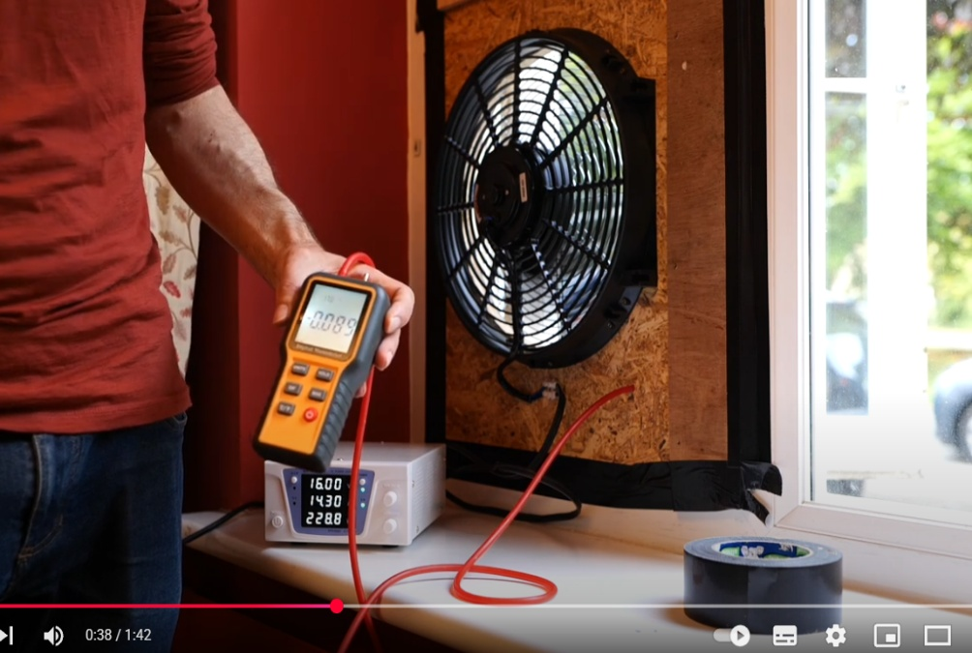
What is deep retrofit – Air tightness
Picture of window fan Extract from Rob video
Taping of window MT Hall
Red line on drawing, penetration schedule, membranes

Slide 9
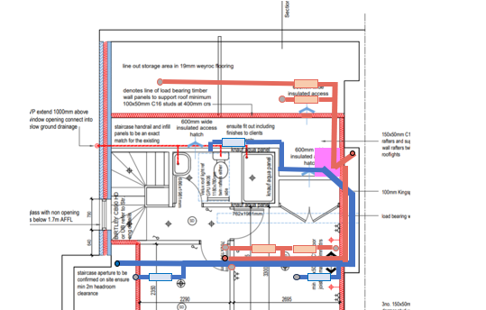
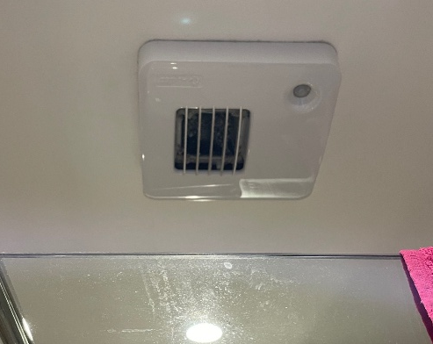
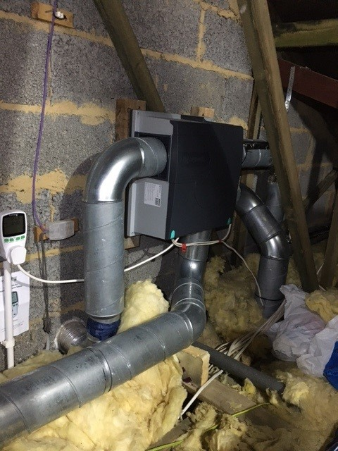
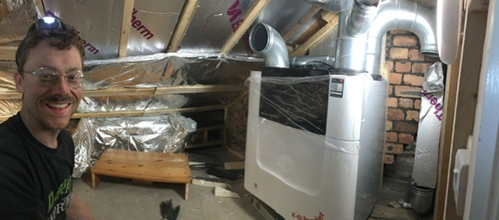
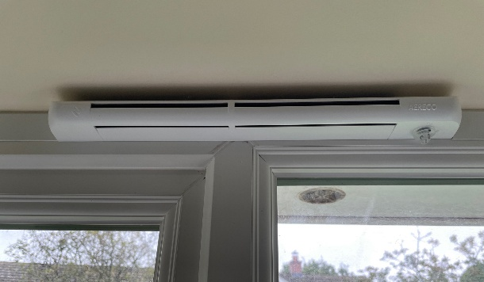
What is deep retrofit – Ventilation
MVHR – Picture of Andy Diagram of pipes - Andy
Aereco – 3 photos, fan in roof, window vent, bath vent
MVHR
MEV
Most retrofit horror stories are caused by lack of a ventilation plan

Slide 10
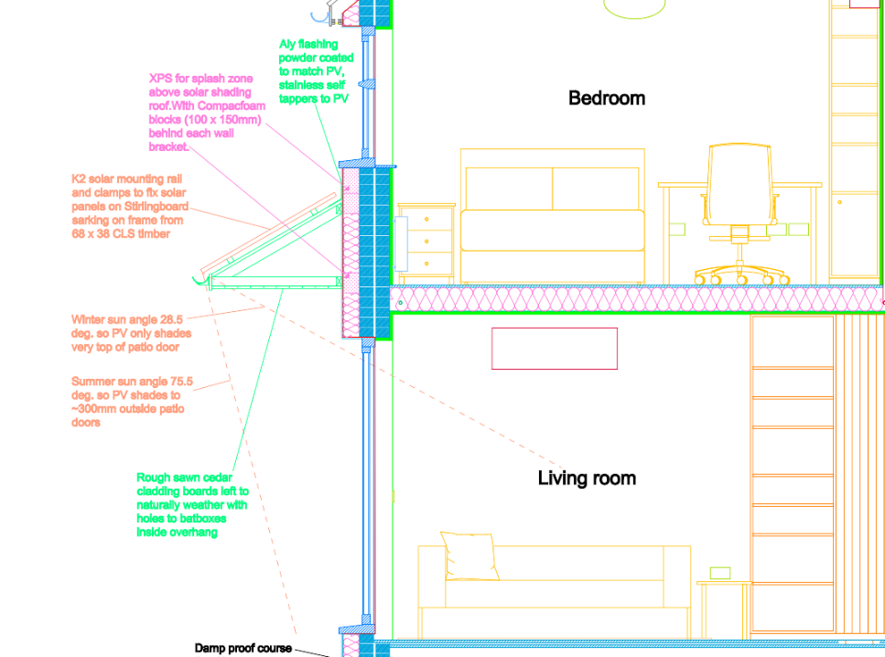
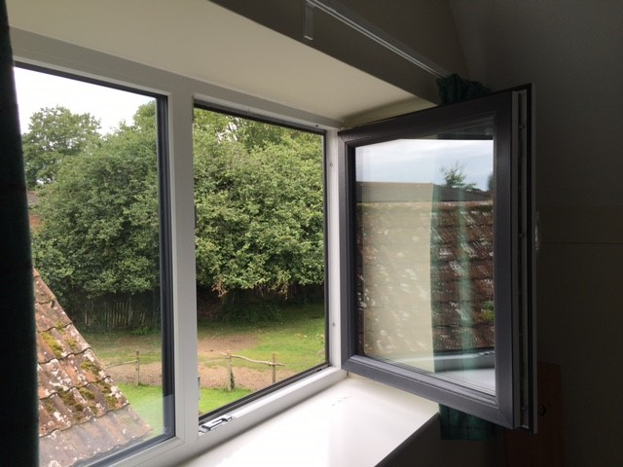
What is deep retrofit – no overheating
Solar shade
77GR
Micro louvres
Solar shade
www.smartlouvre.com/screens
Also deciduous tree shading, Aircon, thermal modelling

Slide 11
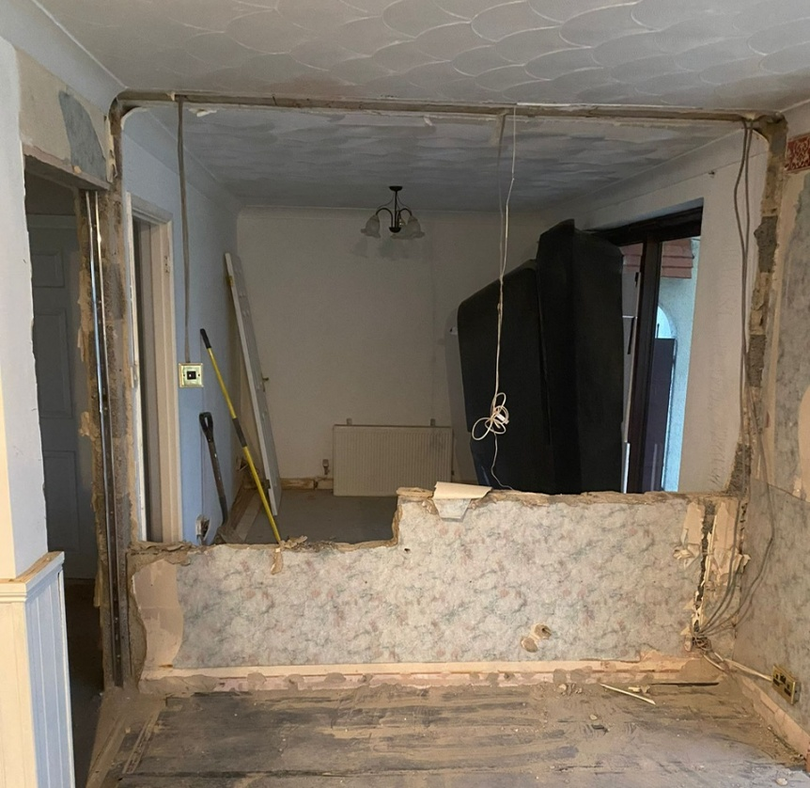
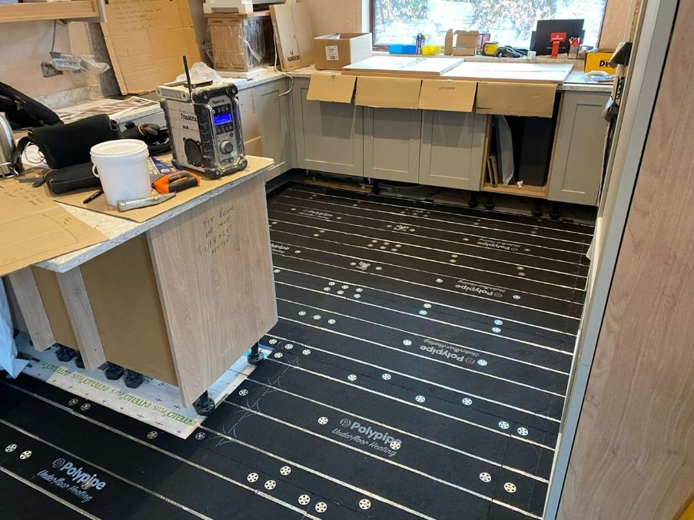
What is deep retrofit – at same time…
Debs Kitchen
Move bedroom wall Deb sitting room
New kitchen
Move bedroom wall
Also new bathroom, underfloor heating, utility room

Slide 12
Retrofit design - Options impact
Improvement | Disruption | Cost | Timing | Benefits | Benefit/cost
External wall insulation | ☹ | ££££ |  | General warmth | £££
Internal wall insulation | ☹ ☹ ☹ ☹ | £££££ |  | General warmth | £££
Roof insulation | ☹ | £ |  | General warmth | £££££
Sloping ceiling insulation | ☹ ☹ ☹ | £££ |  | General warmth | ££
Suspended floor insulation | ☹ ☹ | £££ |  | Warm feet less drafts | ££££
New windows triple glazing | ☹ ☹ | £££££ |  | General warmth Less drafts | ££
New glazing units only | ☹ | ££ |  | General warmth bit less drafts | £££
Demand control ventilation | ☹ ☹ | ££ |  | No damp, fresh air | ££
MVHR | ☹ ☹ ☹ | £££ |  | House feels great less dust | £££

Slide 13
How to retrofit – DIY or tradesperson?
Graph of DIY up side, Time on X axis, 29CR, Rob, Pete/Deb, CRH
Trades you’ll need
Joiner
100% DIY
Builder
Rob
29CR
PV & Battery
Plumber
Retrofit Designer
Electric-ian
100% Contractor
Pete Deb
MVHR
EWI
6 mth 18 mth 10 yrs
Plasterer
Also rainwater harvesting, EV charger,

Slide 14

CRH Process and responsibilities
CUSTOMER
Assessment
Design
Coordination
CONTRACTOR(S)
Site Work
Preparation Construction Tidy & Handover
Site Work

Slide 15
Process and responsibilities
CUSTOMER
Assessment
Customer needs Energy model Budget Risks
Design
Drawings Specifications Energy model Budget Costings Approx Timings
Coordination
Tender & advise QA & site checks Cost monitor
CONTRACTOR(S)
Site Work
Preparation Construction Tidy & Handover
Site Work
Preparation Construction Tidy & Handover

Slide 16
Thermal analysis & option review
HeatPunk / PHPP / Elmhurst / EPC / Heat pump design

Slide 17
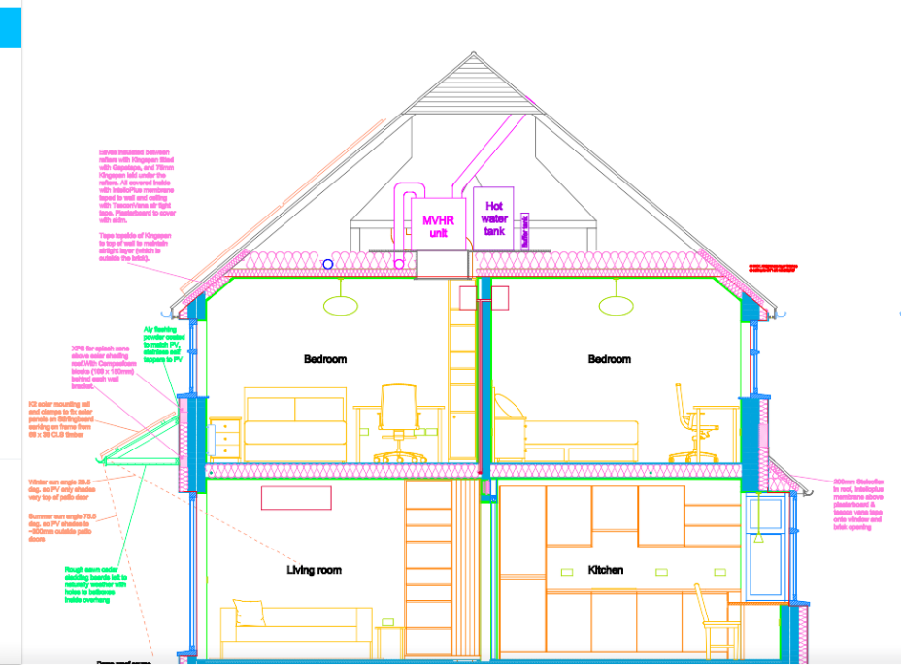
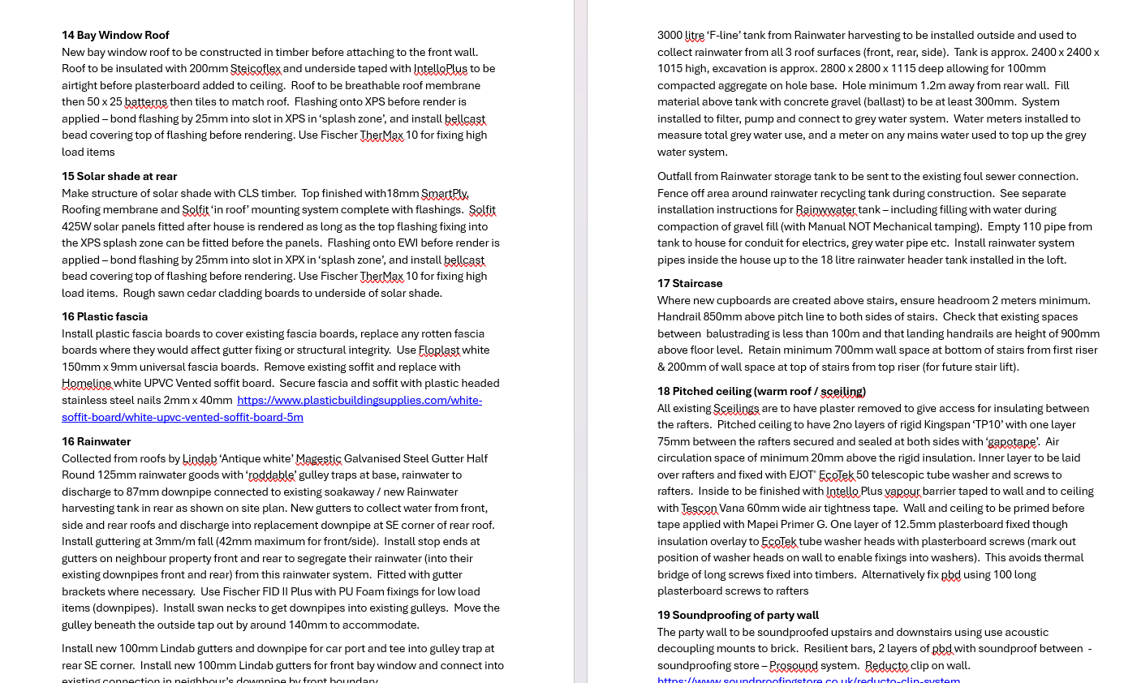
How to retrofit – Design
Picture of Amy drawings
Specification
Drawings
Specification
Also AECB Certified / PHPP? / detail drawings / training

Slide 18
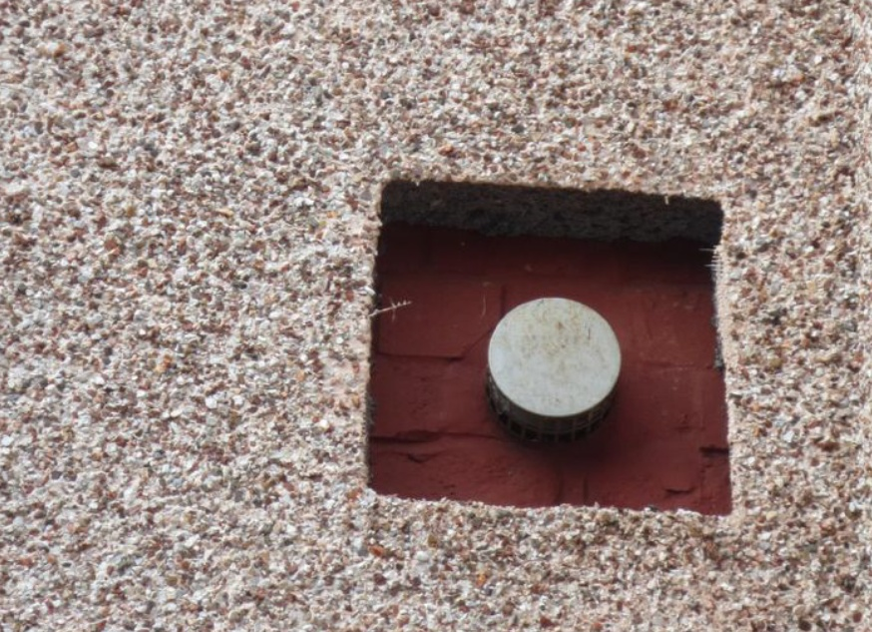
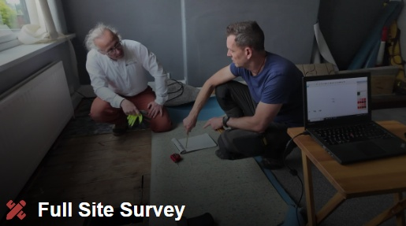
How to retrofit – Coordination
Dodgy quality EWI from Carbon Coop
Photo of Ian in a building site (or Eric)
Poor quality EWI Detail - flue
Retrofit Coordinator on site
Ref: Carbon Coop for EWI photo
Ref: Coldproof.co.uk for site photo
Also AECB Certified / PHPP? / detail drawings / training

Slide 19
One Stop Shop
Cambridge
Grants
Salesmen
Surveyor
Low cost loans
Designer
Project manager
Cashflow
Money
OSS
People
Customer
Quality
Tradesmen
Design guides
Not included
Builders
OSS process
Part included
Materials
Contracts
Contractors
Fully included
Auditing & records
Systems
Components

Slide 20
Retrofit results
Happy Customer
More comfortable house
Sensible running costs
Less dusting (if MVHR)
Healthy home
It’s a lot of money / time
House value increase is less than cost
Buyers won’t be interested
People will think you’re mad
It’s really hard to find another house if you have to move area (except to Ireland).
+
-
www.cambridgeretrofithub.org

Slide 21
Questions
Please put your questions into the chat

Slide 22


Your next steps
Find out how you can get started with your retrofit and book an Initial Retrofit Assessment Consultation with Cambridge Retrofit Hub
Book another tour or talk
Research our past case studies
Book a training session and borrow a thermal imaging camera
Use Transition Cambridge’s personalised home energy advice tool
Please complete the event feedback at the end of this talk

Slide 23
Can you help us?
Make a donation to help us run more Open Eco Homes tours: cambridgecarbonfootprint.org/donate
Share your experiences on social media: #OEH2025
Give us feedback to help improve
Thank you for your support!

