Slide 1


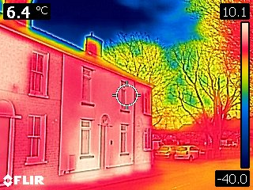
2024/25 Thermal Imaging Report

Slide 2
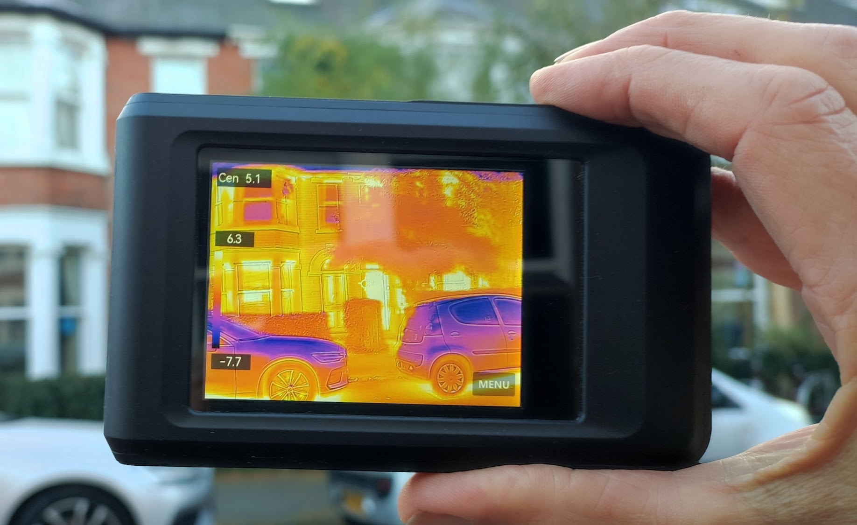
Introduction
Cambridge Carbon Footprint has been offering free training to use Thermal Imaging (TI), and free camera loans during cold months, since 2010.
Borrowers use these cameras to reveal where their homes and other buildings are wasting heat due to poor insulation, draughts, heating problems, and damp. It’s more relevant with the cost of heating our UK homes continuing to be a challenge for many, while accounting for 17% of our national carbon emissions. This service is a wonderful way to engage and enable people, including tenants, to improve their home’s comfort, while cutting their emissions and bills.
Our 2024/25 season from November to early April has been another successful year for enabling residents across more areas of our region than ever before with the inclusion of Huntingdonshire District Council in our scheme.
This season we:
Trained 452 people over four 90 minute online training sessions
Made 325 camera loans
Supported 4 community groups to undertake multiple surveys
Recruited new hosts to make available 18 thermal imaging cameras for loan

Slide 3
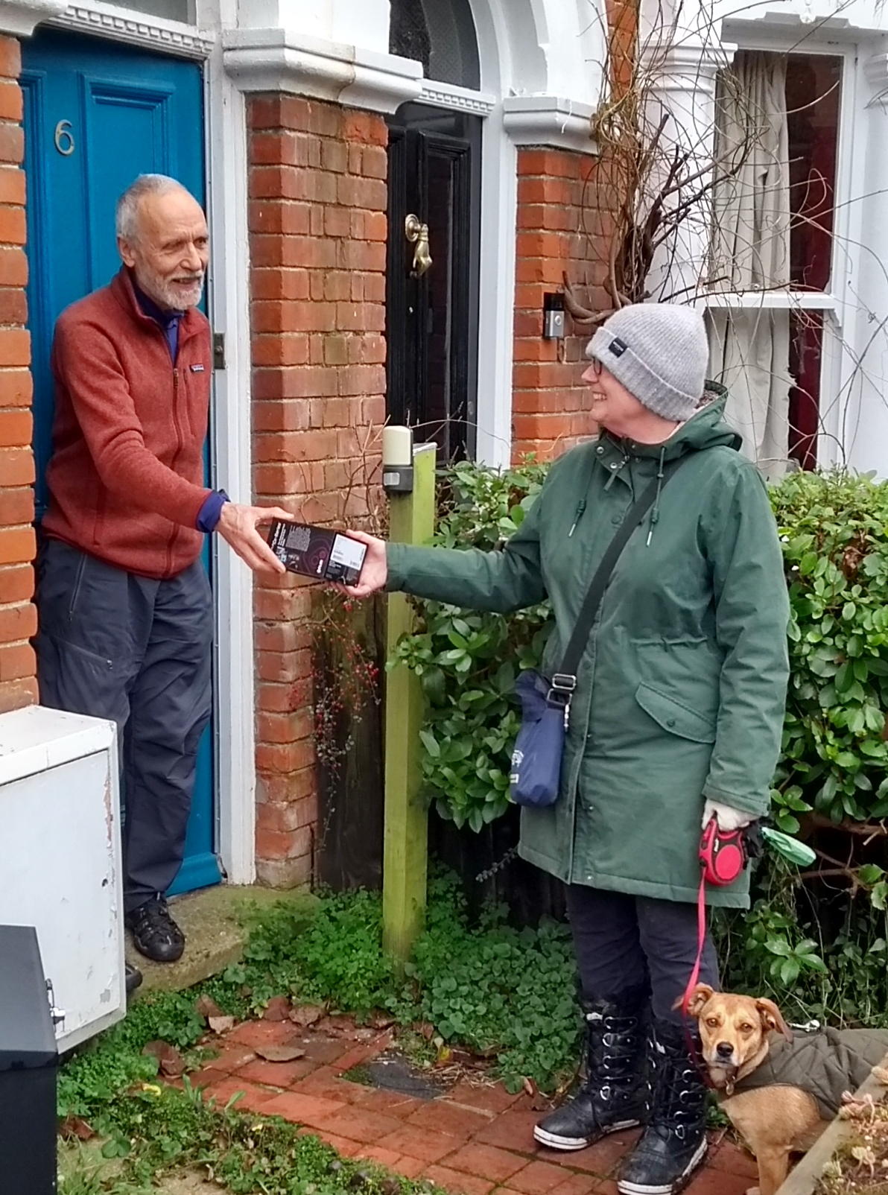
Scope and Aims
Our aims have always been to engage with residents across the region on home energy improvements and lower carbon homes. We provide training and tools for people to understand where their homes are losing heat, and advice and signposting to help them fix this. In 2024, we submitted applications for funding to deliver on our goal of increasing our impact through greater collaboration and increasing capacity.
Specifically, we aimed to:
Run four online training sessions
Train up to 600 people to use thermal imaging cameras
Support community groups to undertake multiple surveys
Enable up to 625 thermal imaging surveys to be completed
Have available 14 + thermal imaging cameras for loan across Cambridge City, South Cambs and Huntingdonshire
Promote thermal imaging through outreach at community events and engagement opportunities

Slide 4
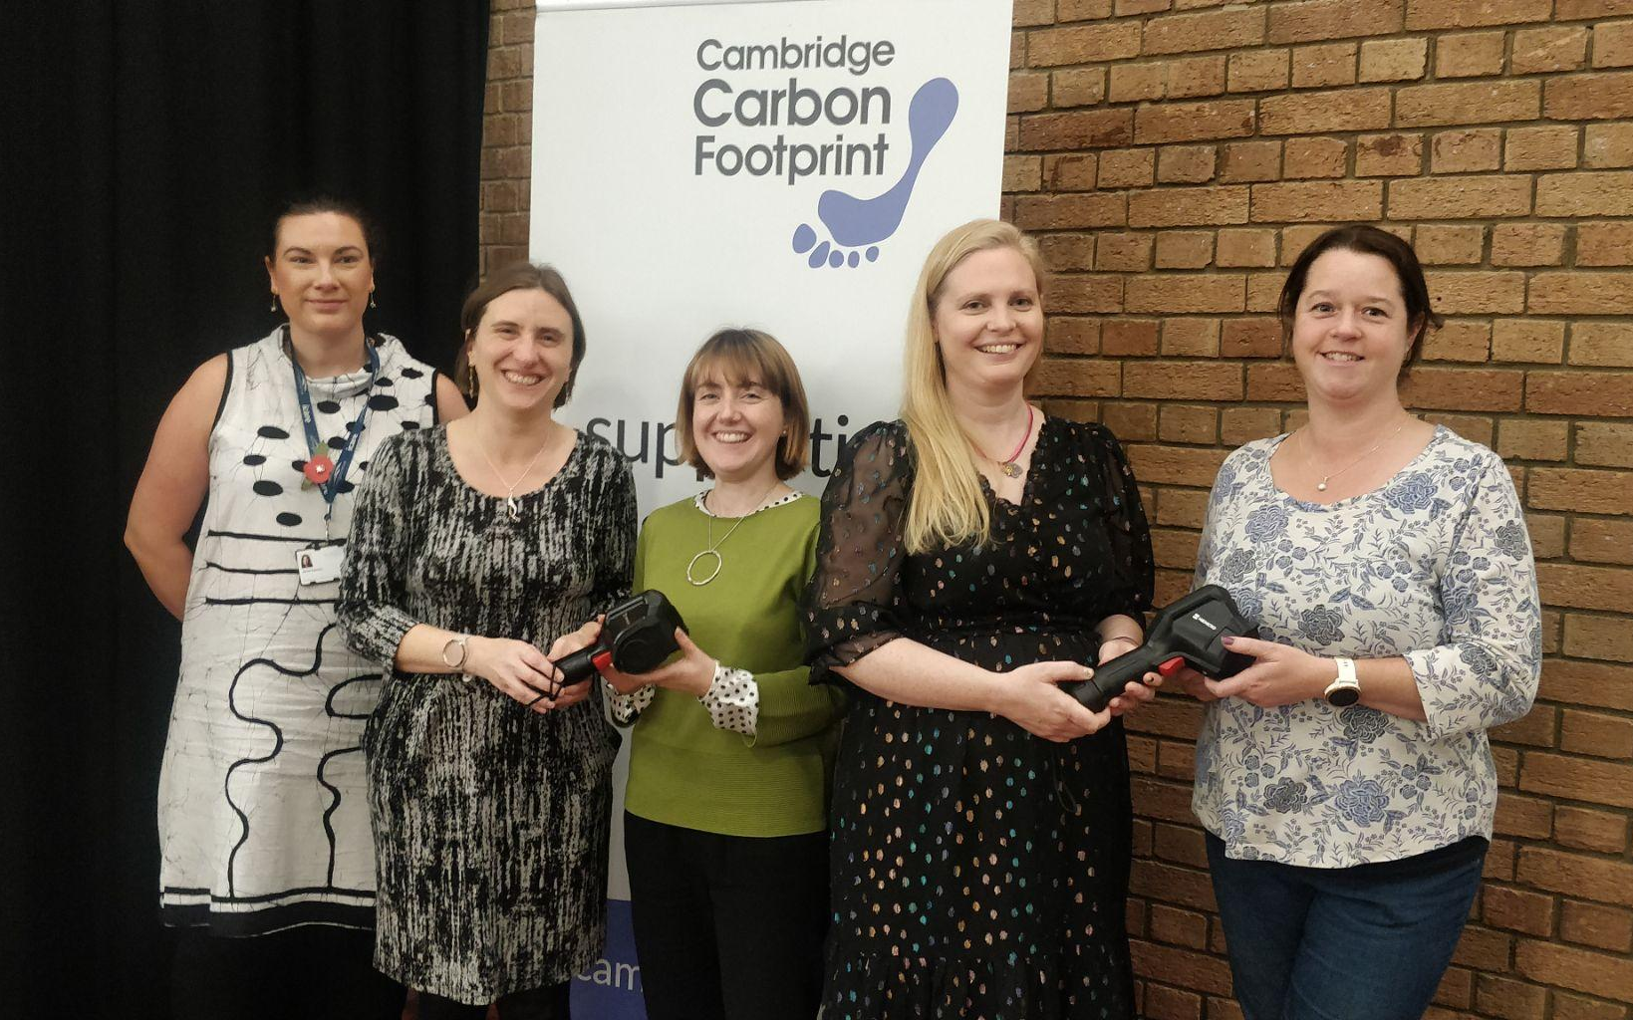
Key Achievements
With the introduction of Huntingdonshire District Council as sponsors of our program this season we have been able to extend our reach wider than ever before and were pleased to be able to offer 18 thermal imaging cameras for loan across Cambridge City, South Cambs and Huntingdonshire.
It was wonderful to work with new volunteer hosts for our cameras and once again support hundreds of people across the region to take the essential steps in improving their home’s energy efficiency and cutting carbon.
This season we:
Ran four 90 minute online training sessions between November ‘24 & Feb ‘25
Trained 452 people
Made 325 camera loans
Supported 4 community groups to undertake multiple surveys
Recruited new hosts to make available 18 thermal imaging cameras for loan

Slide 5
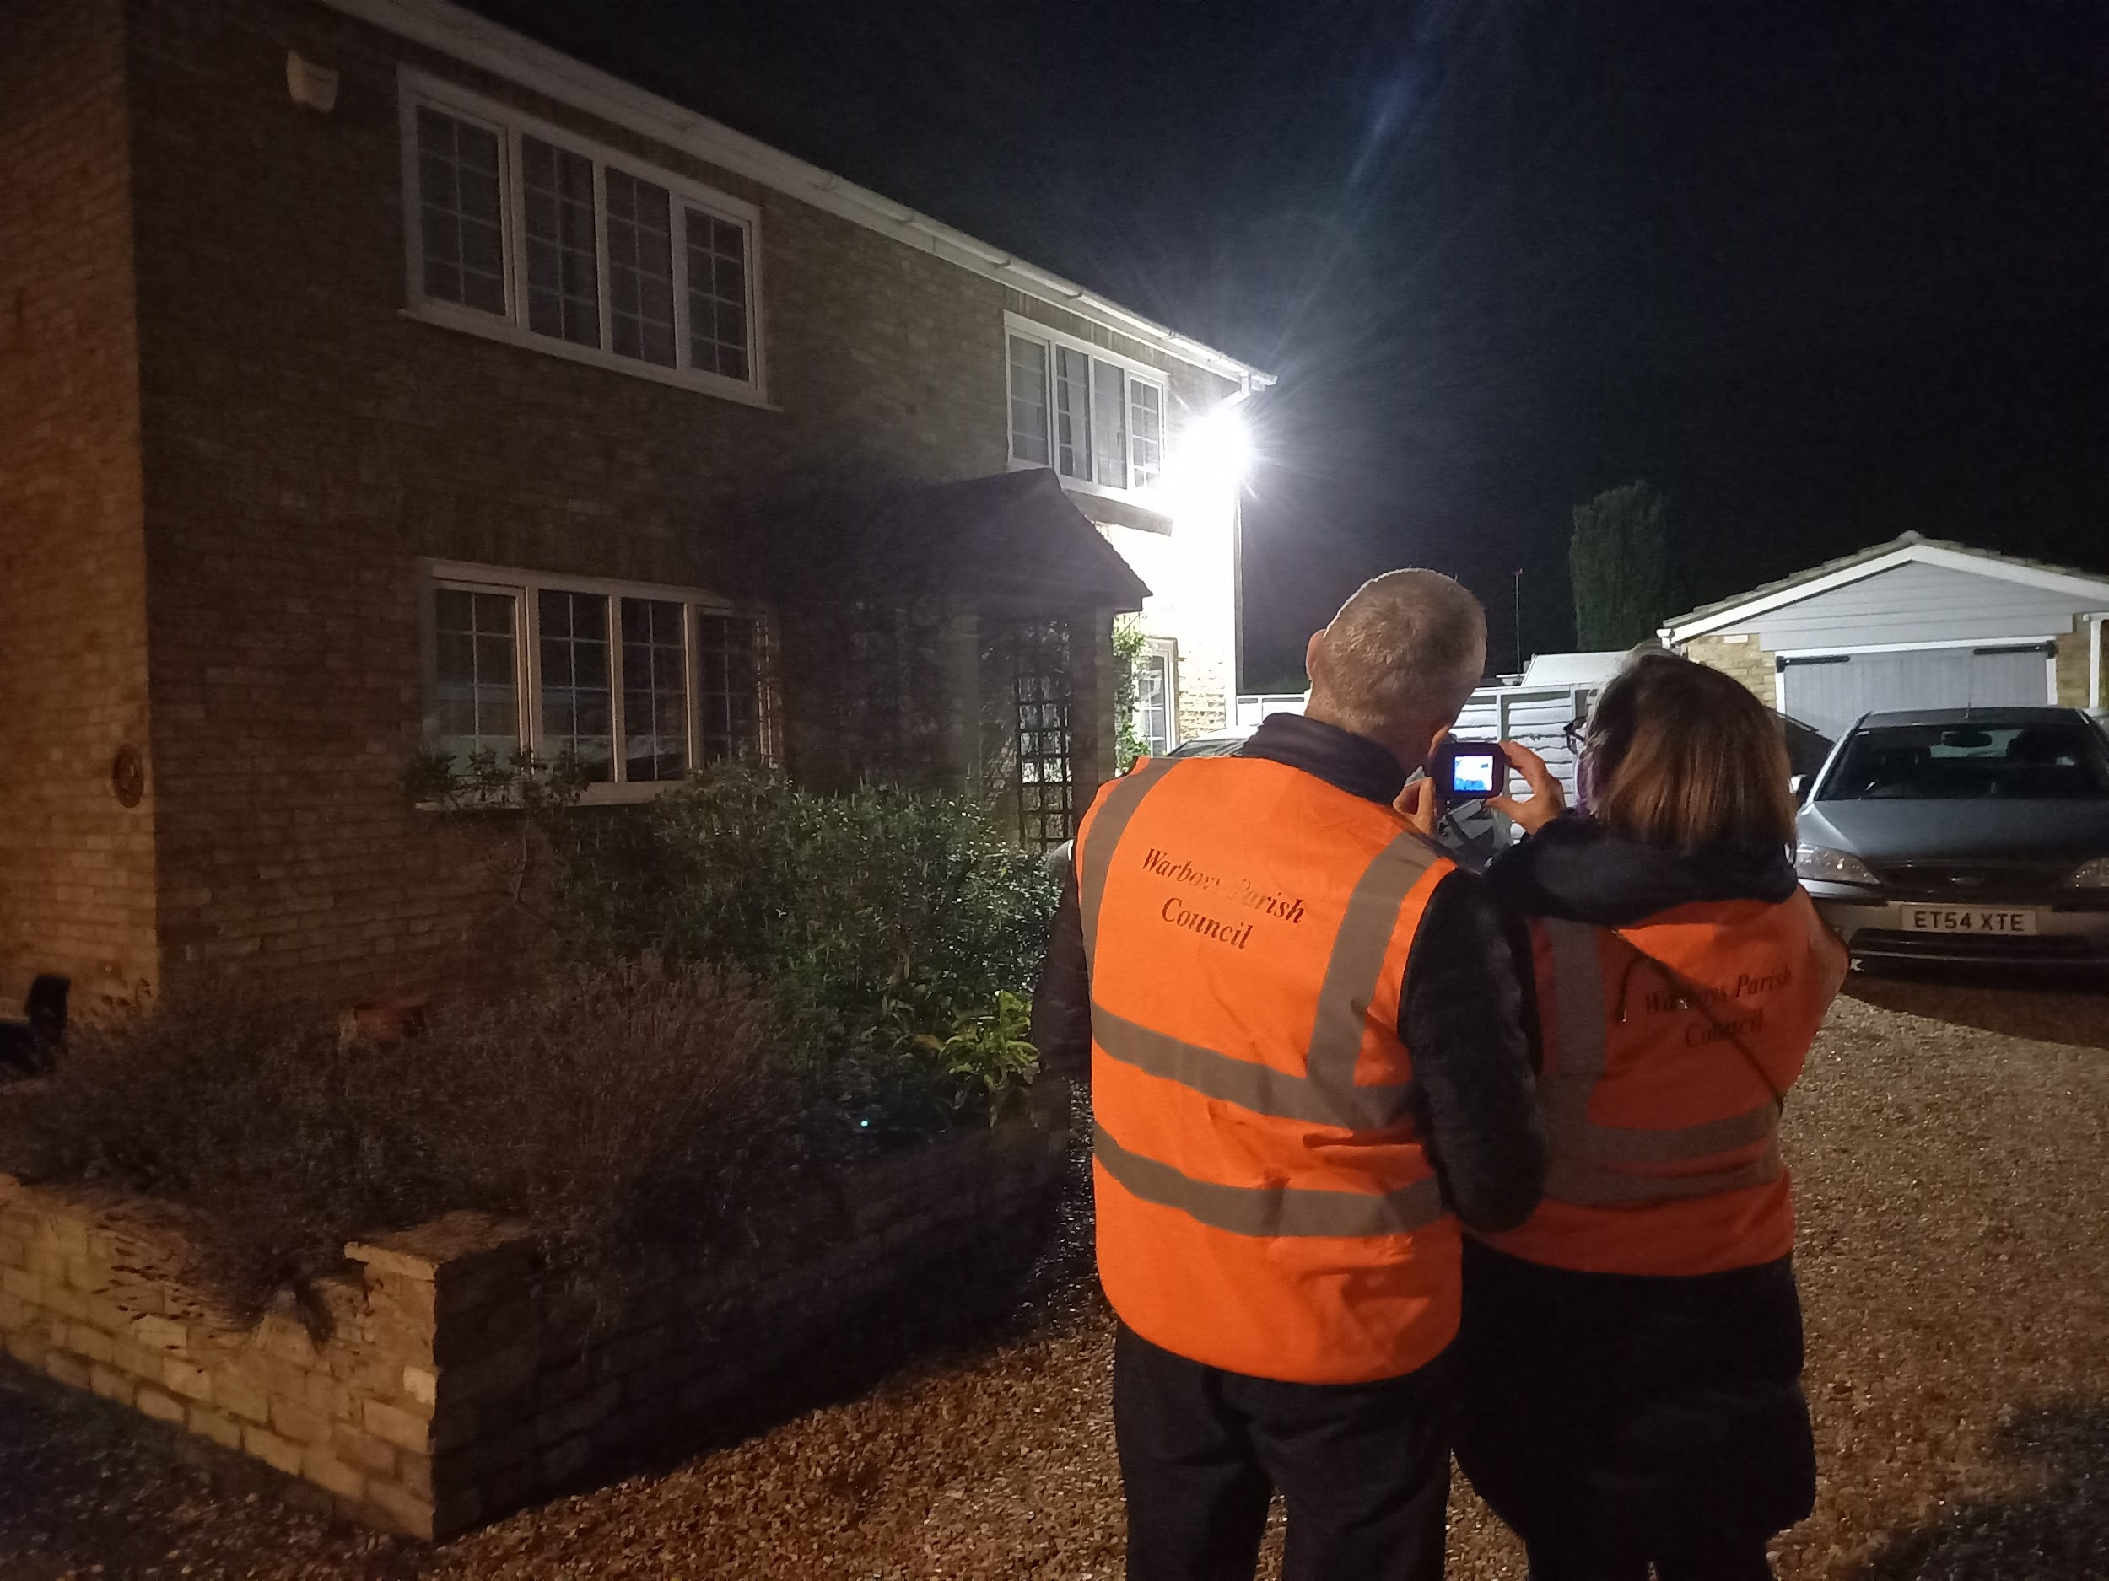




Multiple Surveys
Talks
This season we supported four community groups to undertake multiple surveys in their local area or of their community buildings. We made available one Hikmicro thermal imaging cameras specifically for this use, which borrowers could request to borrow for extended periods.
Warboys Climate and Environment Group
Six trained volunteers surveyed 22 homes over 8 evenings between Dec-Jan, providing survey reports to residents and energy efficiency advice. This is the second year that this group has undertaken this program and this year the Parish Council in addition hosted a thermal imaging camera for loan which they used in this instance. You can find out more about this project by reading the case study produced here.
“We are keen to help householders and those running other buildings in Cottenham, to improve their energy efficiency,” said one volunteer.
Sustainable Cottenham
Between 10-29 Jan four trained volunteers surveyed 24 properties, including a community centre, historic and new homes, a static home and a local nursery. Jan, in thee second year of running this program for the Village. Residents were provided with survey report and energy efficiency advice.
Eversden Parish
Council
Offered surveys to local residents between 11-21 Feb, and surveyed local village hall.
Wildlife Trust
Surveyed 4 properties, office buildings and community education classrooms ranging in age from 10 and around 25 years old through to older buildings 25 years plus.

Slide 6
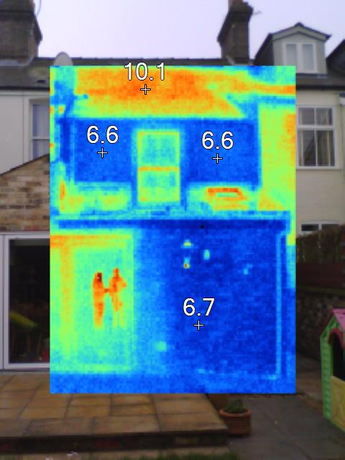
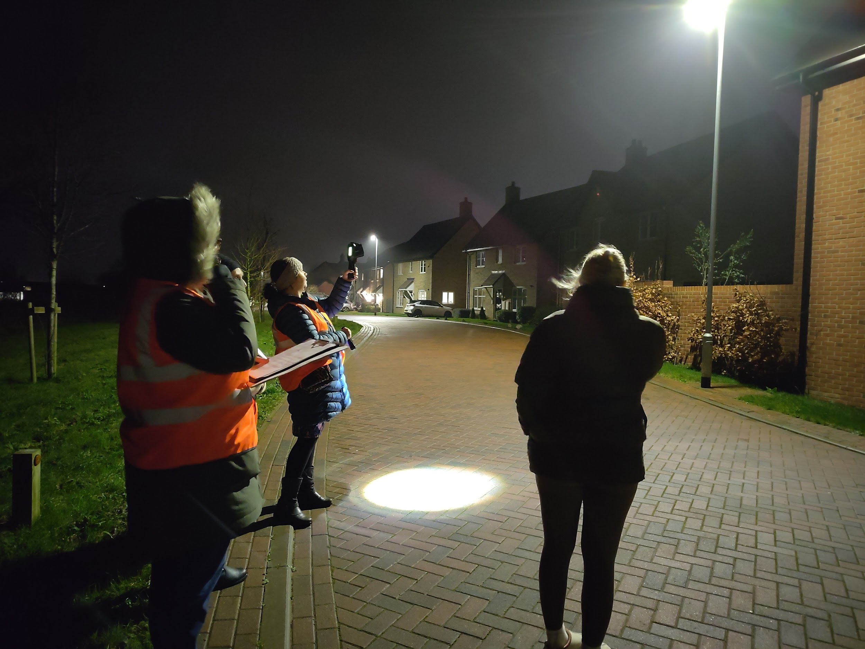
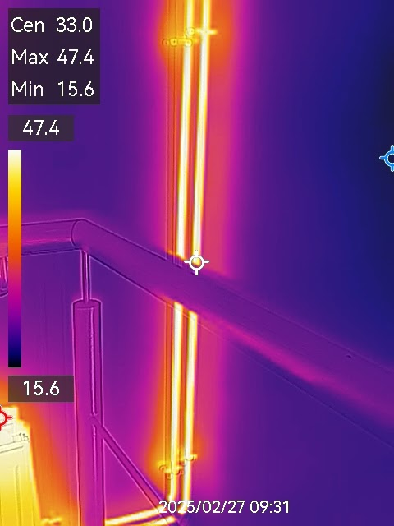
What our audience said
“Definitely do it! The results can be surprising, and issues you may think are the main culprit for leaking heat are not necessarily the ones that have the biggest impact,” camera borrower.
“Absolutely fantastic scheme that is available to the community,” camera borrower from Warboys.
"The thermal imaging camera helped us see areas where we were losing heat through our radiators. As a result, we installed foil reflector insulation behind all our radiators in our home and it's definitely made a positive difference," home owner whose home was surveyed by Warboys Climate and Environment Group.
"I enjoyed helping people to ensure that they are making the most of their precious energy resources was a great thing to do this winter," volunteer from Warboys Climate and Environment Group.
“I would love a forum to share ideas, knowledge, and ask questions to follow up on the findings we make when using the cameras,” camera borrower.
“The training was a really important part of being able to interpret the results from using the camera,” camera borrower.

Slide 7

Funding Thermal Imaging
Funding for our Thermal Imaging program has increased this season with the additional funding from Huntingdonshire District Council to expand our service with the region.
This season we received generous support from our funders:
South Cambridgeshire District Council (SCDC) Zero Carbon Communities Grant £3661.35*
Huntingdon District Council (HDC) £2802.50 (including £1250 grant from HDC Futures Grant)
Cambridge City Council (CCC) Sustainable Cities Grant £990*
Donations £507
We are also extremely grateful to all of our supporters who lend and host thermal imaging cameras for us. In particular this includes SCDC, HDC, Sentec, Bidwells and Anglia Ruskin University.
*based on a percentage of a total grant awarded towards CCF Home Energy work.

Slide 8
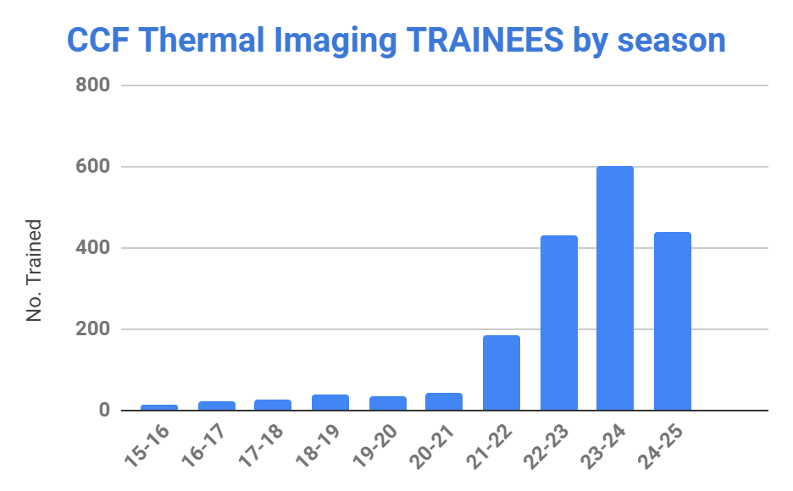
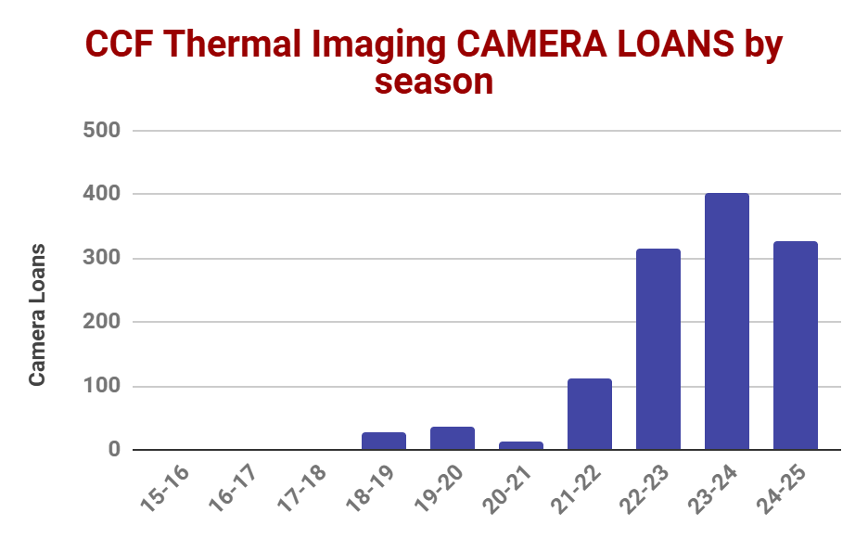
Key Lessons
Whilst there has been a noticeable drop in participation this season, numbers are in alignment with 2022/23 figures and reflects a peak in 2023/’24 following the energy crisis. Our staff had to focus more resource on advertising and promoting the scheme this season than expected.
The number of borrowers completing our online survey reports has reduced. This is voluntary for borrowers, but enables us to collect information on how the cameras are used, what measures people take as a result of borrowing, and vital feedback for the whole process.
Using data from returned borrower surveys over the past few seasons we can see a trend showing that approximately 1 in 5 borrowers survey one or more properties. This means that this season approximately 55 more buildings have been surveyed.
Some feedback suggested a desire for training to be more accessible, possibly as a pre-recorded webinar available on our website rather than live sessions.
Areas of improvement:
Training to ensure the scheme’s accessibility matches demand
Collection and collation of borrower feedback to increase response rate.
Marketing and promotion of the programme across the region, looking at increased community engagement and media.

Slide 9
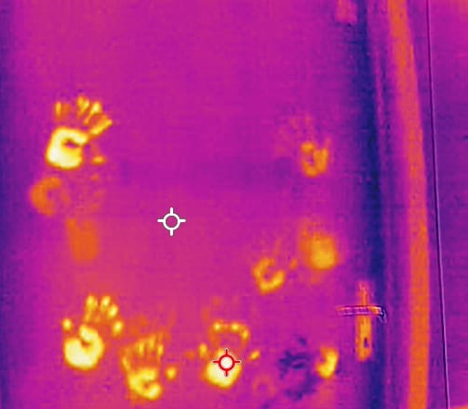
Conclusion
The 2024/25 thermal imaging season has seen a big increase in our capacity, with the addition of more thermal imaging cameras available to lend, new volunteer hosts, and trainers ensuring high quality content and equipment is available to residents across the region.
With the inclusion of Huntingdonshire this season we have been able to undertake a study of community groups offering volunteer led thermal surveys to people within their parishes and towns. The responses that these groups received from homeowners demonstrates the incredibly positive impact schemes like these have, bringing people together, spending time talking and helping one another to better understand needs and the challenges people face in moving to lower carbon homes.
Those who participate in this our thermal imaging scheme regularly report increased knowledge and confidence in understanding and improving their own home energy efficiency, resulting in warmer, more comfortable homes.
Finally, a special thanks:
It is only with the dedication of our truly fabulous volunteers, and the generous support from our funders & sponsors that we are able to continue providing our thermal imaging service year on year. Thank you all!

