Slide 1



Climate Change Gardening
Add image here
21 Sept 2024

Slide 2

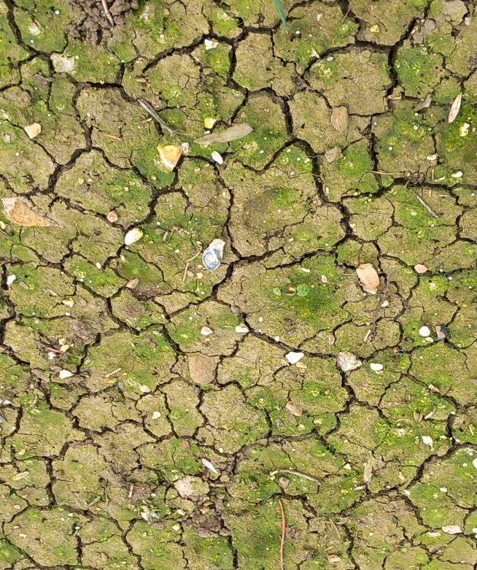
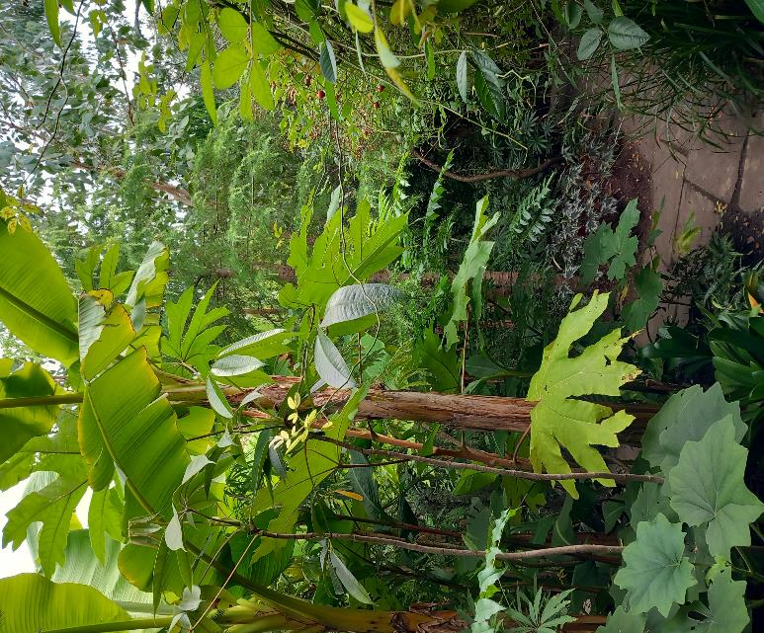
Climate change, gardening, and us

Slide 3
Are we concerned about climate change?
“74% of adults in the UK are very or somewhat concerned about climate change” (ONS)
Overall, there is a 26% gap between the actual proportion of people who are willing to participate in climate action (69%), and the average perceived proportion (43%).
(Globally representative evidence on the actual and perceived support for climate action, Peter Andre et al, Nature Climate Change 2024)

Slide 4

So, how is climate change affecting our gardens?
87 pages.
Chapter 7 addresses eastern England
2017
An overall gradual increase in average temperatures, in all seasons – a potentially longer growing season.
Drier and hotter summers, and milder, wetter, winters.
But also, more variability, eg late frosts, heavy rain, droughts.

Slide 5
How should gardeners respond to climate change?
1. Accept and adapt?
2. Soften the impacts?
3. Reduce our CO₂ emissions?
4. Carbon capture?

Slide 6
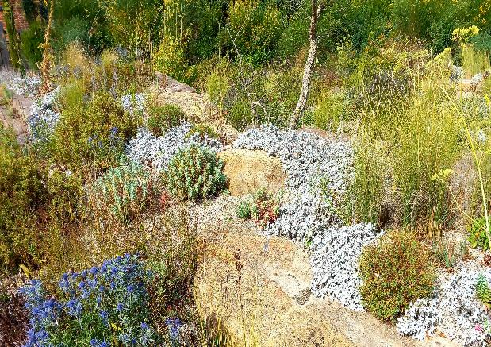
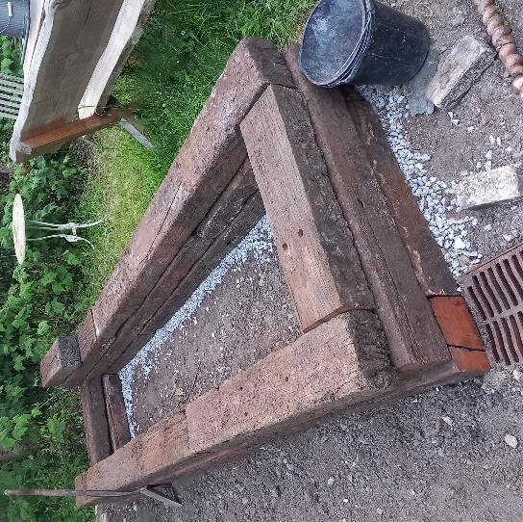
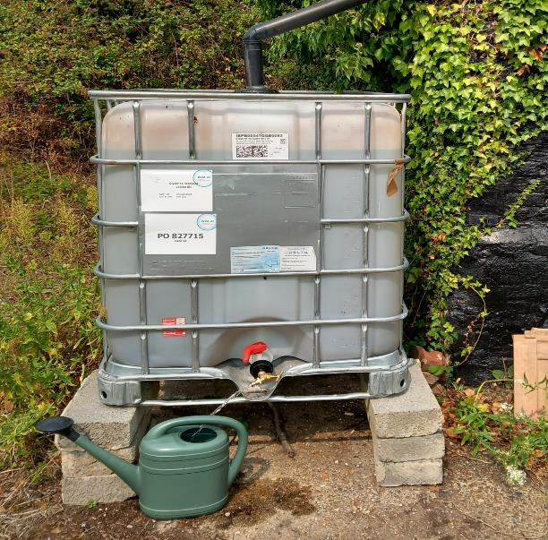
Accept and adapt
Drought-tolerant planting:
Cambridge Botanic Garden
Beth Chatto’s garden
RHS Hyde Hall
Raised beds, to avoid water-logging.
Collect and use as much rain-water as you can. Reduces abstraction and the demand on aquifers.

Slide 7
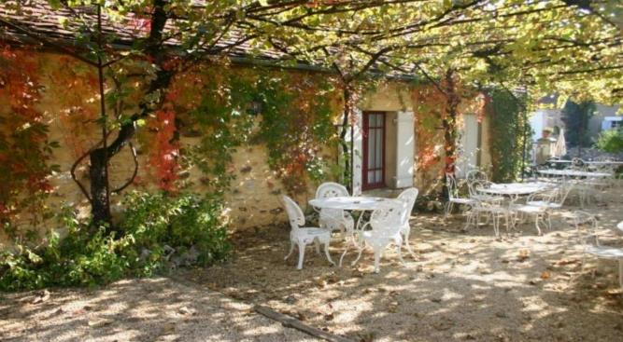
Soften the impacts
As the climate warms, cooling shade is increasingly important.
Tree-lined streets are noticeably cooler, especially in hot weather.
Shaded surfaces, such as paving and walls, stay cooler in hot weather.

Slide 8

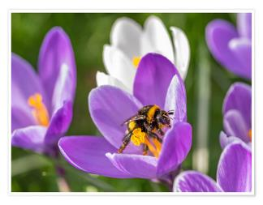

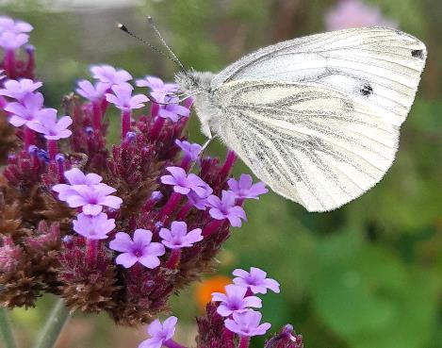
Soften the impacts
Choose flowers where the nectar and pollen are accessible to insects.
Nectar available, from spring to autumn.

Slide 9
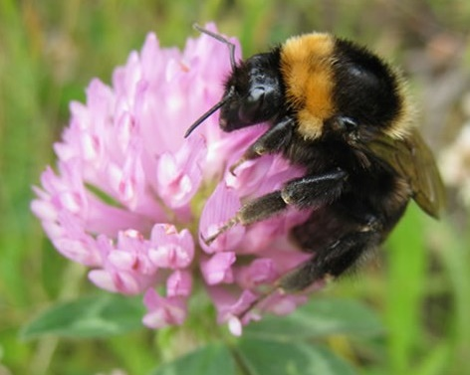
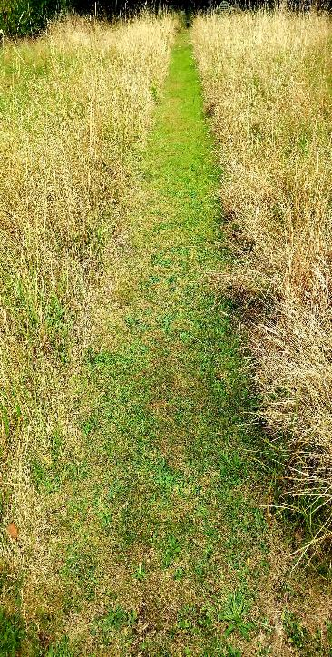
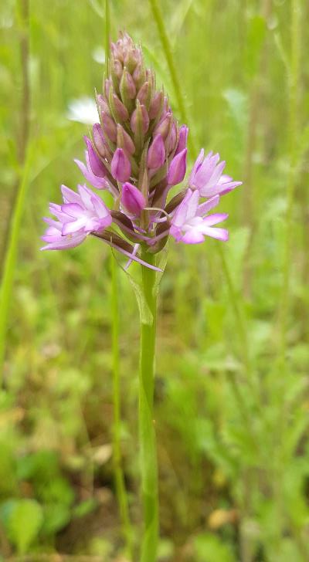
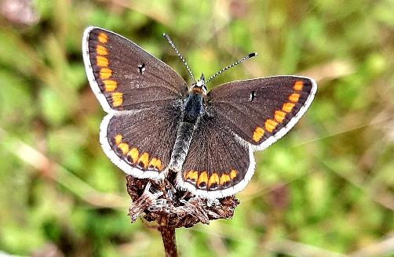
Soften the impacts
Leaving your lawn to grow long over the summer, will improve biodiversity, and capture more carbon.

Slide 10
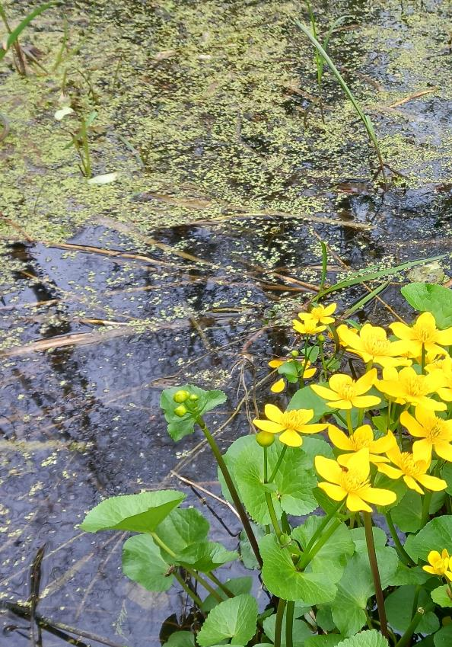
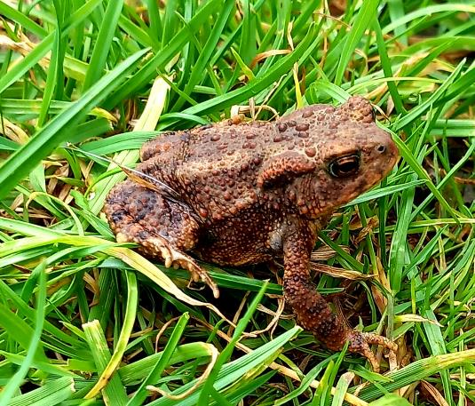
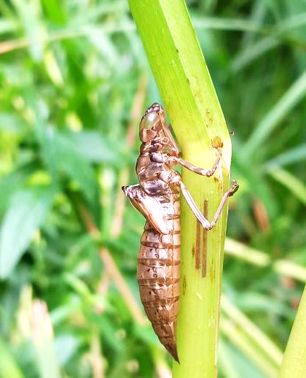
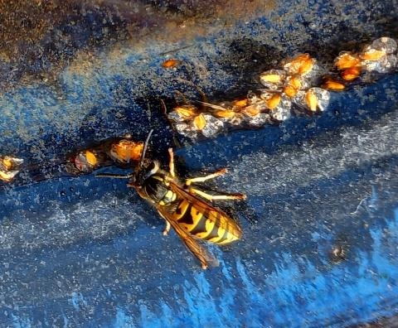
Soften the impacts
Garden ponds, even small ones, support aquatic and terrestrial wildlife.

Slide 11
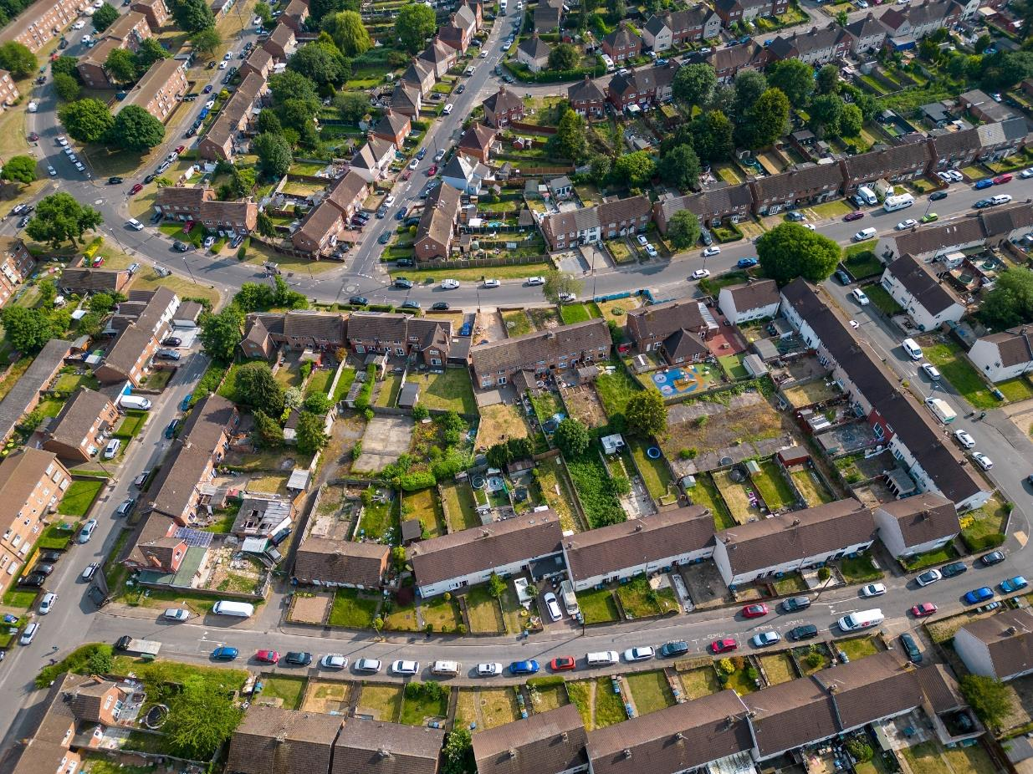
Soften the impacts
Individual oases of garden habitat, linked up to form ‘green corridors’.
For wildlife, gardens are a shared space.

Slide 12
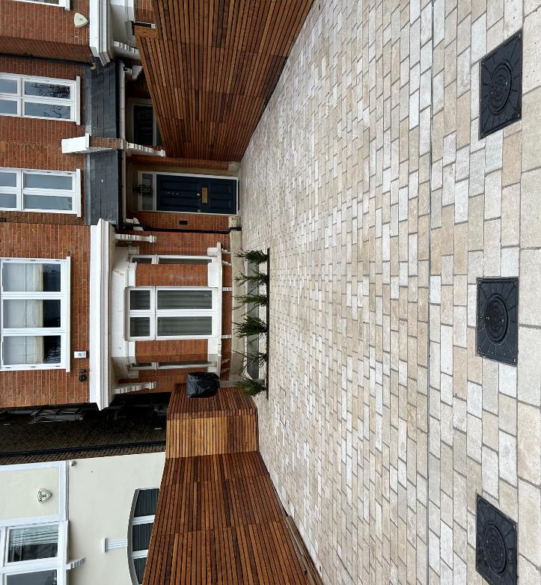
Reduce our CO₂ emissions
Hard paving:
Is responsible for c.8% of global CO₂ emissions.
Absorbs and re-radiates heat – hot nights in the city.
Sheds water – flash flooding.
Lost opportunity for CO₂ capture.
Minimise new paving, use recycled or permeable materials, or just de-pave.
Switch from petrol to electric tools, or use manual tools where possible.

Slide 13
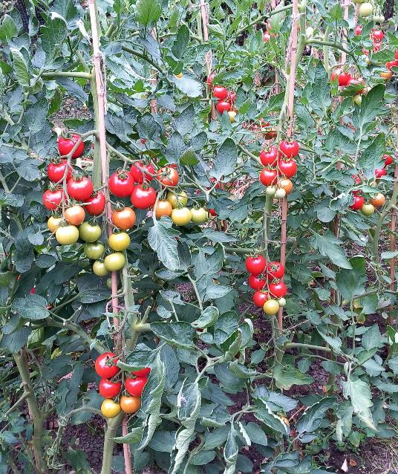
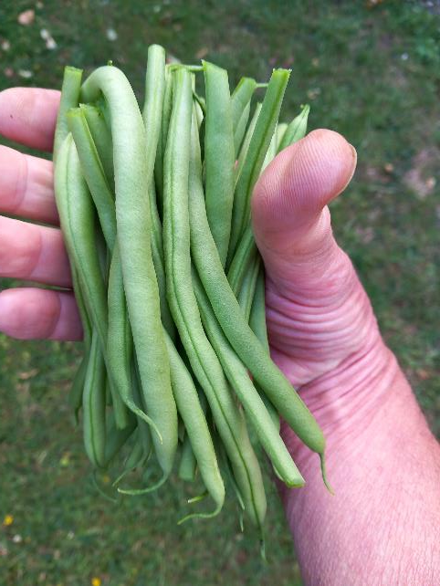
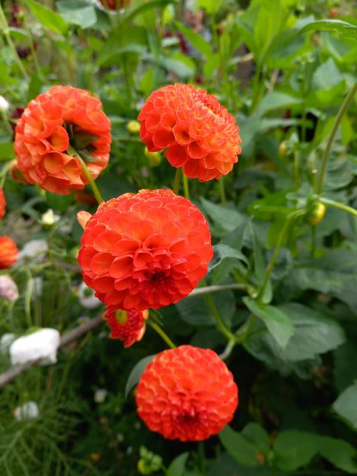
Reduce our CO₂ emissions
Home-grown produce has a smaller carbon footprint than commercial produce.

Slide 14
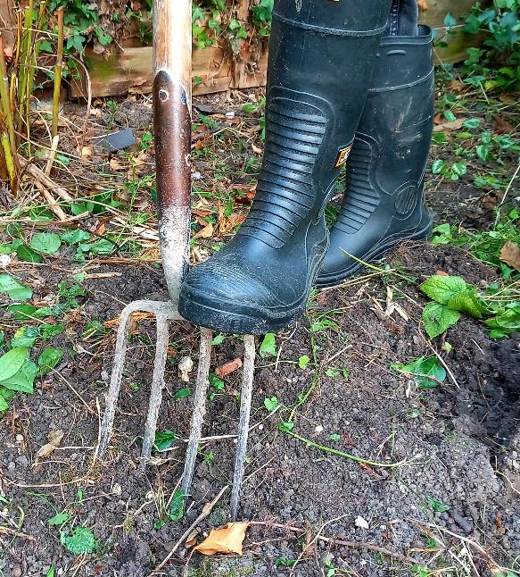
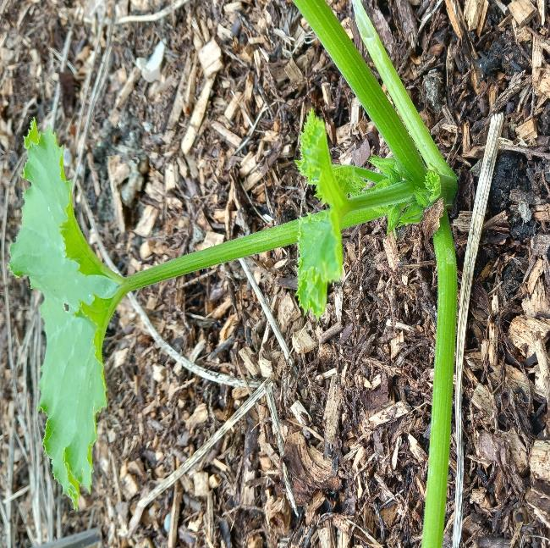
Reduce our CO₂ emissions
Whenever soil is dug or turned, carbon is oxidised into the air.
‘No-dig’ keeps carbon in the soil.

Slide 15
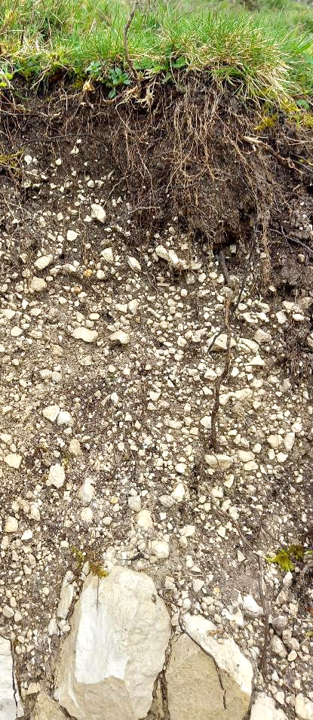
Increase carbon capture
Undisturbed soil naturally contains carbon, from plant material. 10 billion tonnes of carbon in UK soils.
However, through intensive agriculture and urbanisation, 40 – 60% of this carbon has now been lost to the air (Environment Agency).
Increasing the amount of carbon in degraded soils by 0.4%/yr, would compensate for much of global CO₂ emissions.

Slide 16
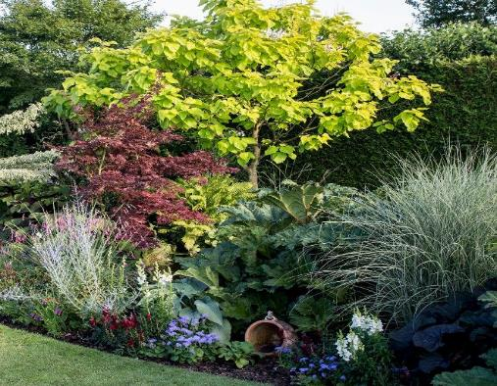
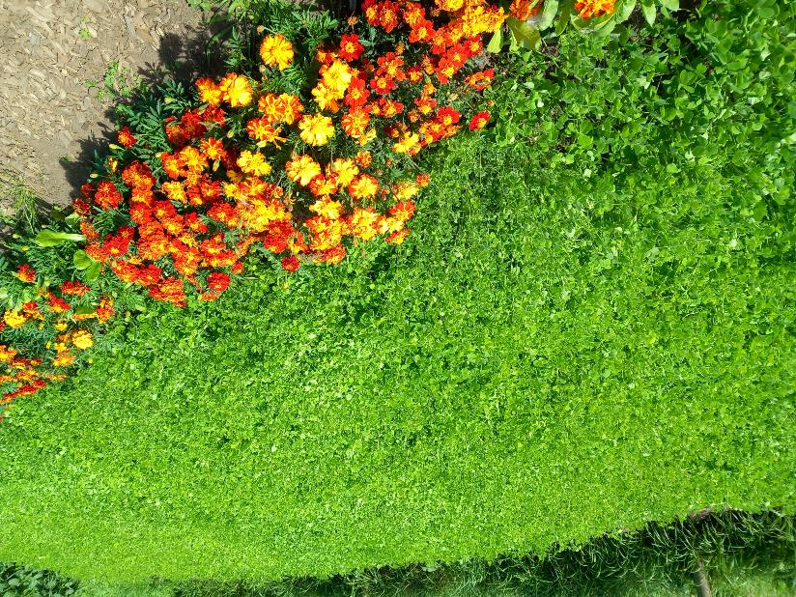
Increase carbon capture
Plant more perennials and trees.
Plant cover crops on bare soil.

Slide 17
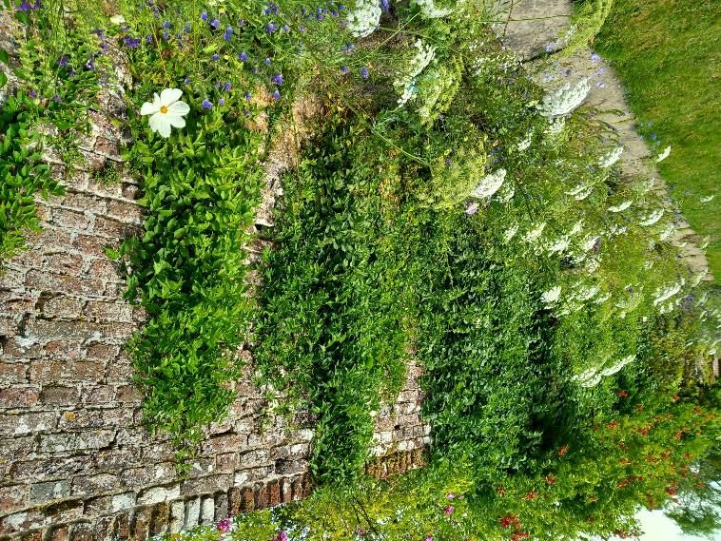
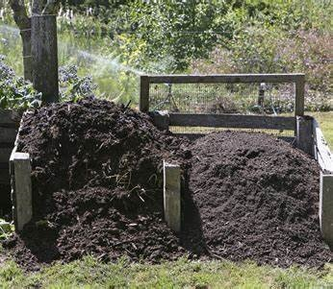
Increase carbon capture
Avoid peat. Use surface mulch and compost to return carbon to the soil.
Plant foliage to cover hard surfaces.

Slide 18
My garden is quite small - will any of this make a difference?
In England, private gardens are the 3rd largest land-use category.
They cover 2400 square miles, almost 2x the area of Cambridgeshire, and more than all nature reserves combined.
Around 25 million people enjoy gardening. Together, modest changes in gardening practice, can have a large impact on carbon emissions.
    Eg, a bunch of home-grown flowers can save up to 8kg of carbon, compared to a bunch of imported flowers.

Slide 19
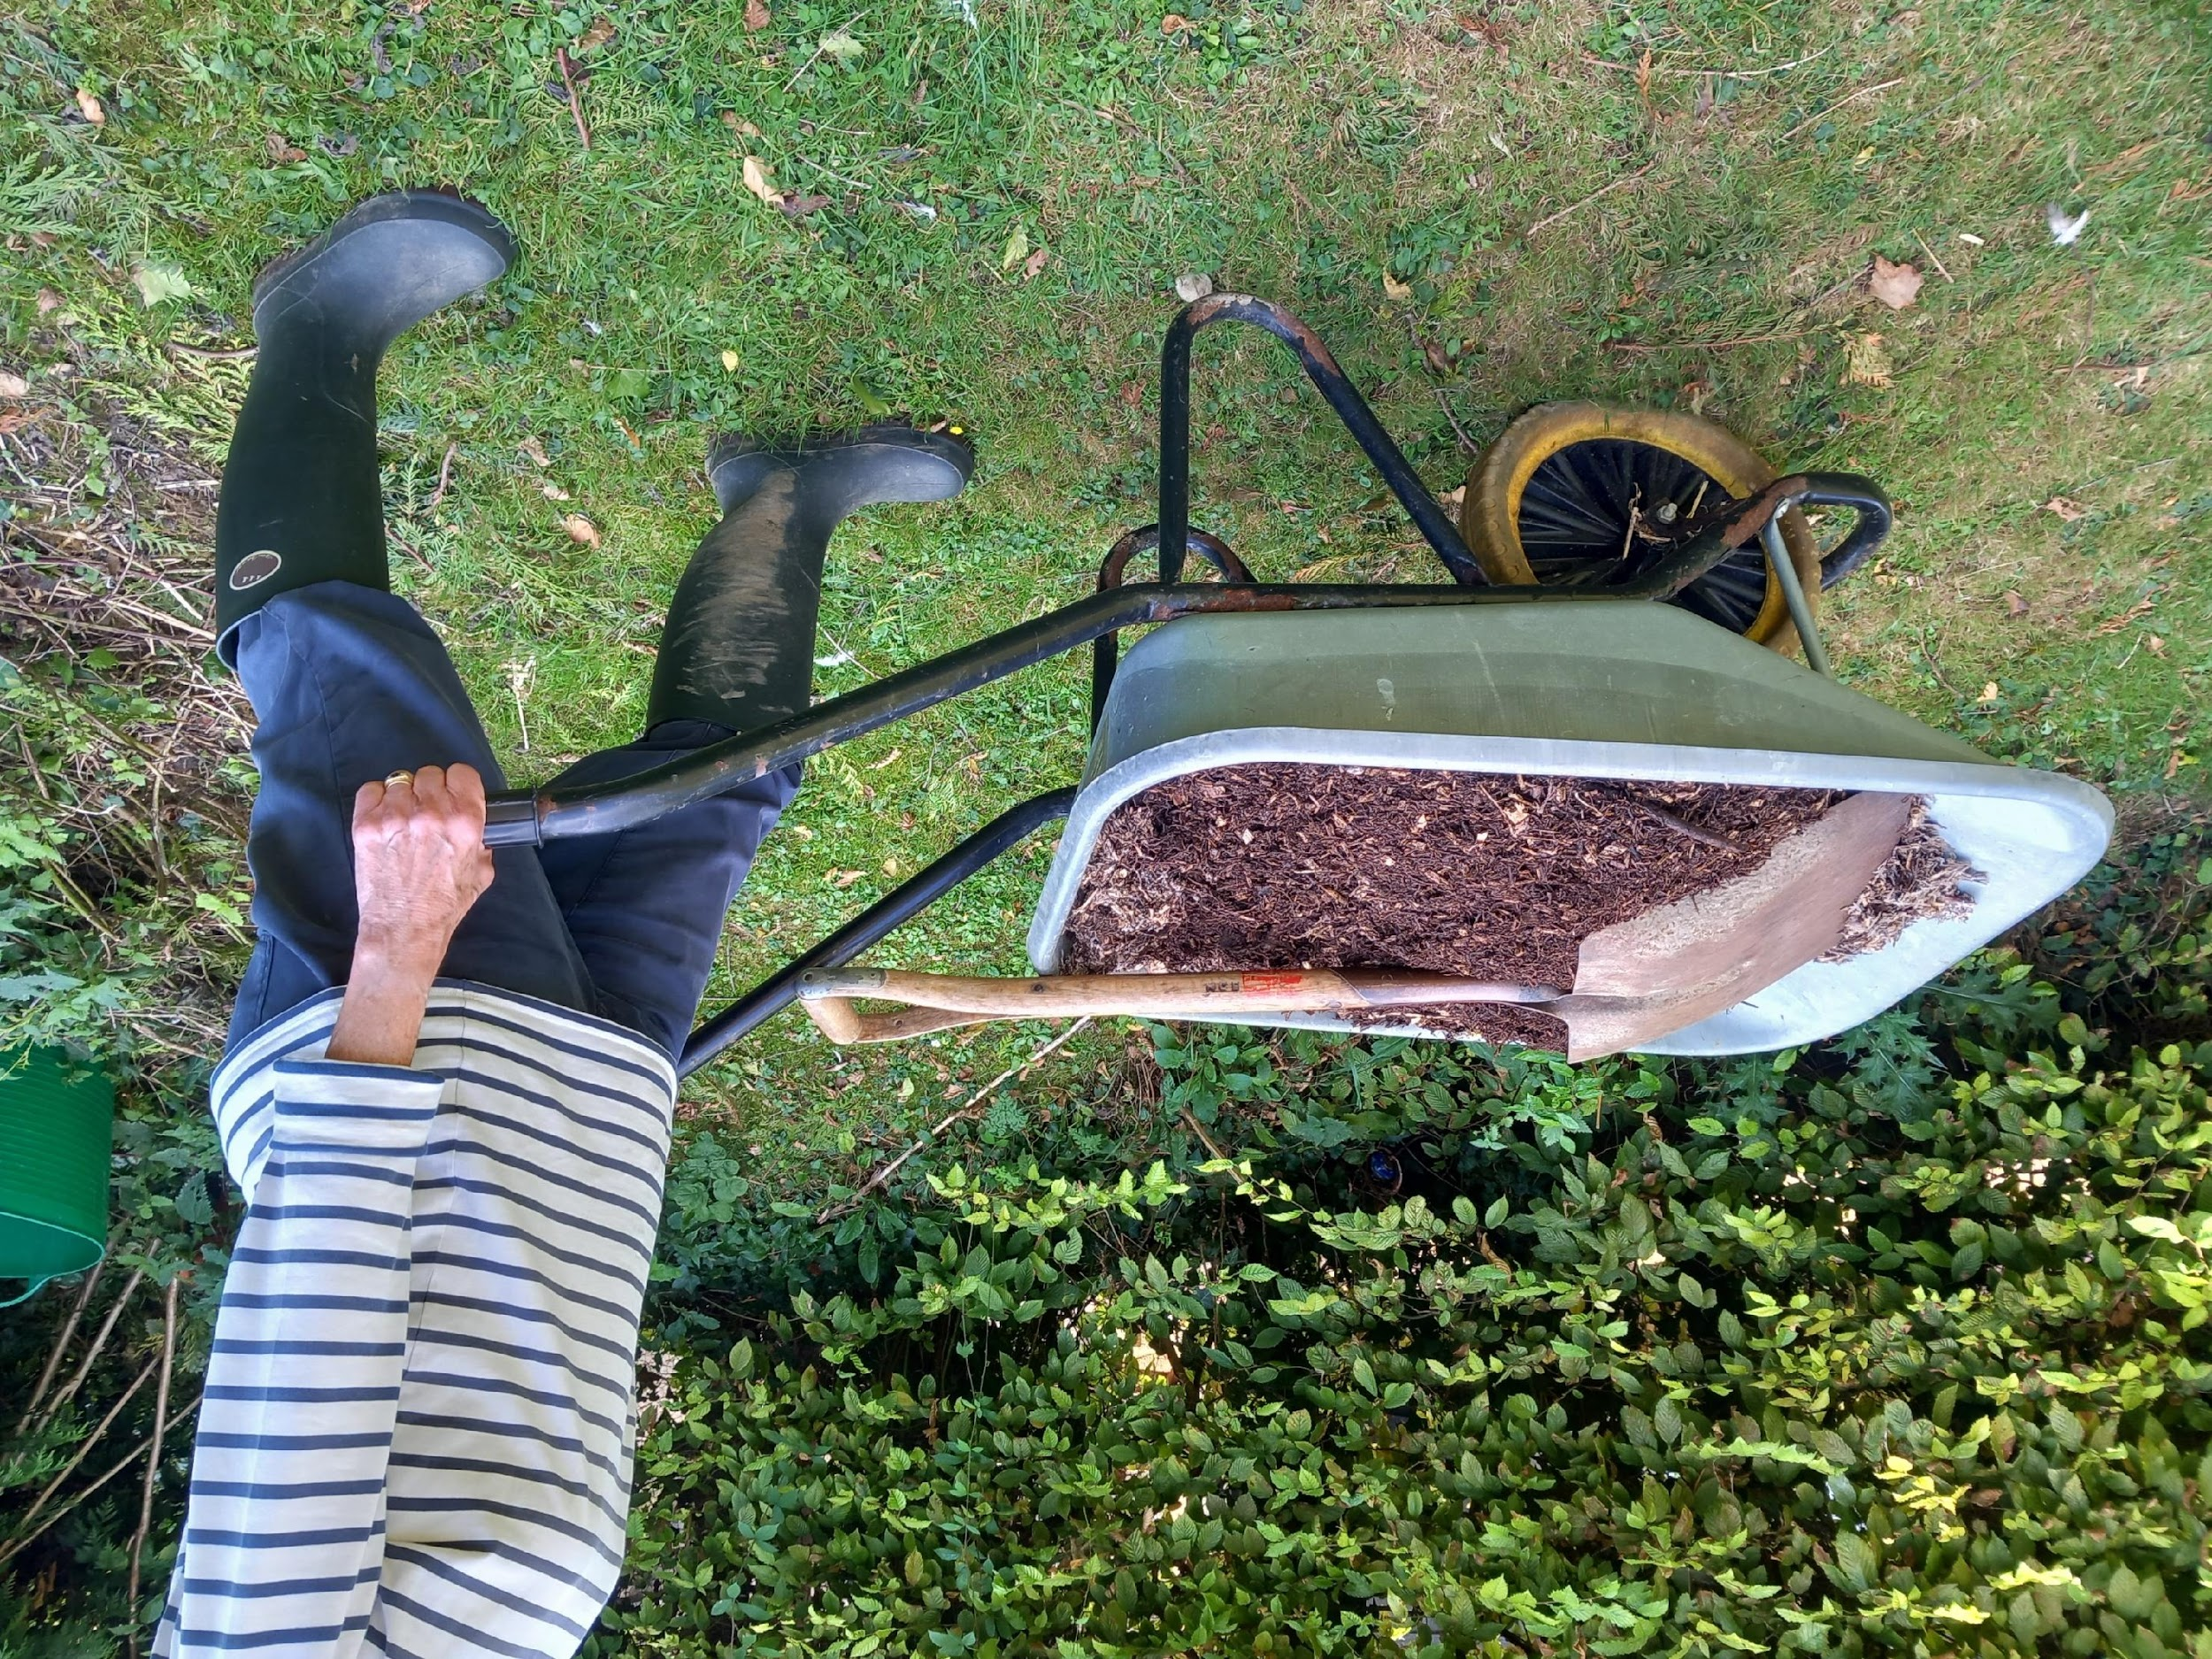
There are so many possibilities – where do I start?
You don’t have to do everything all at once.
Start with a project that is achievable, suits your garden, and your budget.
Together, we can have a positive impact on climate change!

Slide 20
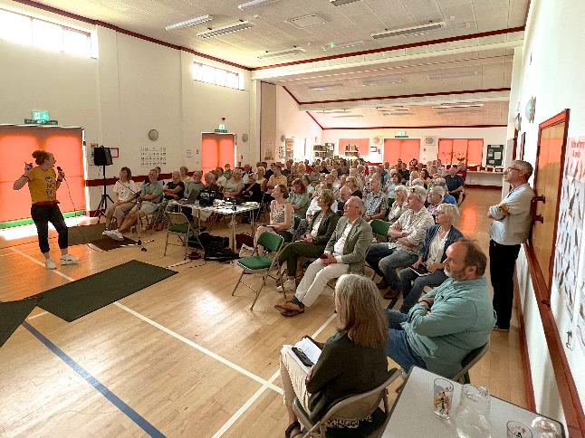
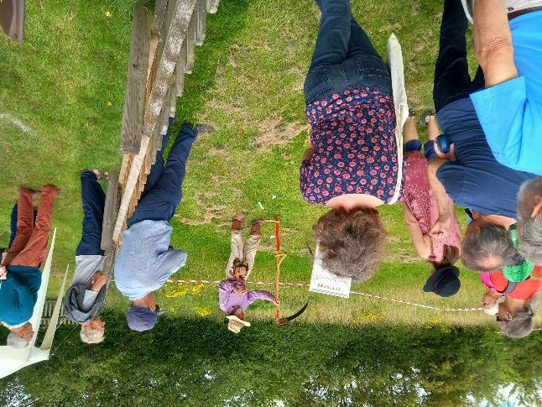

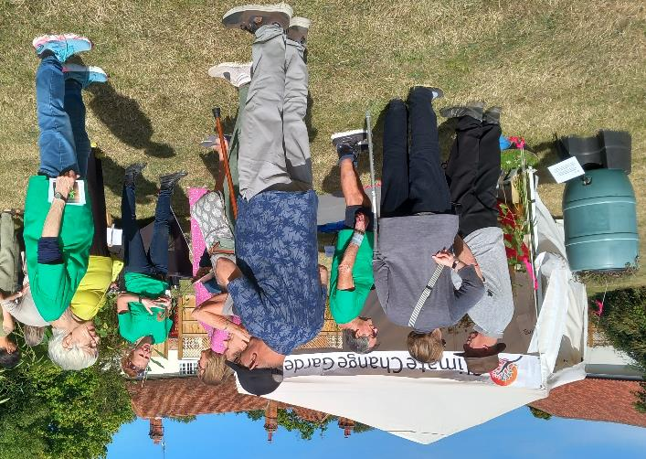
We are now a charity, encouraging gardeners to adopt climate change mitigation measures. (Charity Registration Number: 1208653)
www.climatechangegardening.org

Slide 21
Your next steps
Find out how you can get started with your retrofit
Book another tour or talk
Research our past case studies
Book a training session and borrow a thermal imaging camera
Use Transition Cambridge’s personalised home energy advice tool
Please complete the event feedback at the end of this talk
Notes:
CCF and Open Eco Homes will be at the Greening your Home talk at Cambridge Central Library on Sat 7th Oct in the afternoon….Greening your home - with a top climate scientist Tickets, Sat 7 Oct 2023 at 14:00 | Eventbrite
Low Carbon Heating Options talk on Monday 9th Oct Low Carbon Heating - Cambridge Carbon Footprint
An book to speak with an expert about your own home energy questions and needs at our Home Energy Human Library Event at the Grand Arcade on Sat 21st Oct Human Library on Home Energy - Cambridge Carbon Footprint

Slide 22
Can you help us?
Make a donation to help us run more Open Eco Homes tours: cambridgecarbonfootprint.org/donate
Share your experiences on social media: #OEH2024
Thank you for your support!

